Slide 1
Chombo BootCamp Lecture 3: MultiDim Chombo

Slide 2
Example: Phase-space
In some contexts, can be useful to think in terms of a phase space made up of physical and velocity dimensions
Example: 2+2D (2 physical, 2 velocity dimensions: (x,y,u,v)
Often want to work in both the full 4D and the reduced 2D spaces
Working example in Chombo MultiDimPhase example
Chombo/example/MultiDimPhase
Document in ChomboDoc/newDocs/multiDim.*
1+1D example $(x,v)$:
Hyperbolic advection in 2D: $\frac{∂f}{∂t}+ \frac{∂vf}{∂x}+ \frac{∂af}{∂v}=0$
$a=−\frac{∂φ}{∂x}$
1D Elliptic equation for φ: $\frac{∂^{2}φ}{{∂x}^{2}}\left(x,t\right)=4π\int{f\left(x,v,t\right)dv}$

Slide 3
MultiDim Chombo
“normal Chombo -- compile-time dimensionality
Dimensionality is pervasive (SpaceDim, D_DECL, etc macros, ChF)
Solution – namespaces
Each dimensionality lives in its own distinct namespace: (Chombo::D1)
Transdimensional utilities for moving between dimensions
(inject from D to D+1, slice from D to D-1)
Reduction and Spreading utilities within a single dimension
ReductionCopier, SumOp, SpreadingOp
Spreading done by defining ReductionCopier, then calling reverse() function
Most of the time, work in a single dimensional namespace
Only worry about dimensionality in the interface points

Slide 4
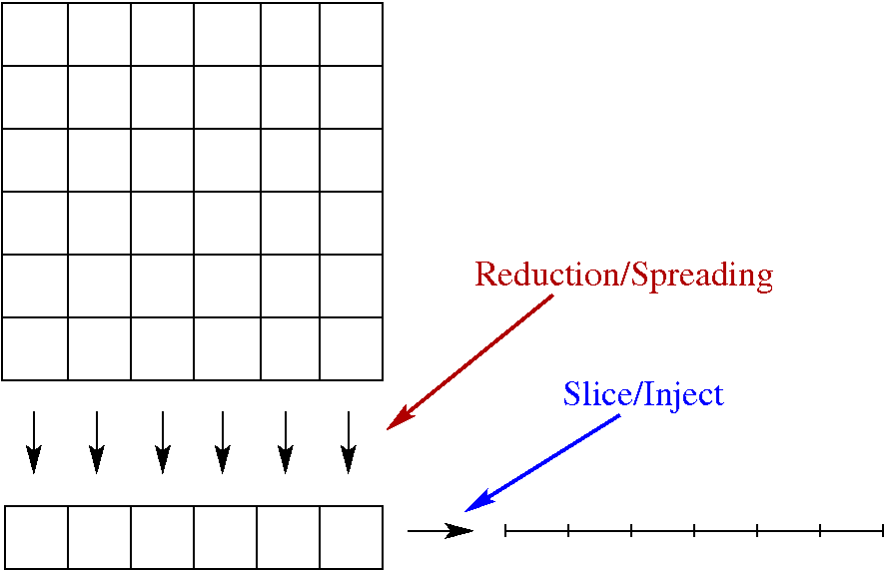
MultiDim, cont

Slide 5
Example : Reduction by summing in y-direction
// function to reduce a 2D LevelData<FArrayBox> to 1D by // summing over the y-direction
void reduce2DTo1D(D1::LevelData<D1::FArrayBox> >& destData, D2::LevelData<D2::FarrayBox> >& srcData) {
// create 2D version of 1D boxes
D2::LevelData<D2::FarrayBox> sliceGrids;
D2::SliceSpec slice(1,0);
injectDisjointBoxLayout(sliceGrids, srcData.getBoxes(), slice);
// define sliced data holder
D2::LevelData<D2::FArrayBox> reducedData(sliceGrids, srcData.nComp);

Slide 6
// define ReductionCopier to compute intersections //(sum in the y-direction)
int transverseDir = 1;
ReductionCopier reduceCopier(srcData.getBoxes(), sliceGrids, 1);
SumOp op(transverseDir);
op.scale = 1.0;
/* do summing operation -- sums data in srcData along lines in the y-direction and places sum in reducedData */
srcData.copyTo(srcData.interval(),
reducedData, reducedData.interval(),
reduceCopier, op);
/*finally, take the data in reducedData (which is a 2D object) and slice to 1D */
sliceLevelData(destData, reducedData, slice);
}

Slide 8
MultiDim Builds
Special build system
BaseTools library has no dimensionality
Other Chombo libraries can be used with any DIM
Special headers placed in Chombo/lib/include/multidim
Chombo/lib/MultiDim contains transdim support
Slicing.H.transdim, Injection.H.transdim
Use 2 GNUmakefiles in local build directory
GNUmakefile: specifies ebase, MINDIM, MAXDIM, MULTIDIM_MAKEFILE
GNUmakefile.multidim: specifies libraries and src directories:
1dLibNames, 2dLibNames, 3dLibNames, …
1dsrc_dirs, 2dsrc_dirs, 3dsrc_dirs, …
mdsrc_dirs (files without a compile-time dimension)

Slide 9
GNUmakefile:
#the location of Chombo lib dir
CHOMBO_HOME = ../../../lib
ebase = phase
MINDIM = 1
MAXDIM = 2
# this is the local GNUmakefile which contains this example's
# multidim build info -- libraries and src directory information
MULTIDIM_MAKEFILE = GNUmakefile.multidim
# this is the default target, which just invokes the all-multidim target
all: all-multidim
# this file contains the basic rules used to build multidim codes (using
# the GNUmakefile.multidim in this directory), including the shell script
# which orchestrates the make process
include $(CHOMBO_HOME)/mk/Make.multidim.basic

Slide 10
GNUmakefile.multidim
## Define the variables needed by Make.example
# the location of Chombo lib dir
CHOMBO_HOME = ../../../lib
# names of Chombo libraries needed by this program, in order of search.
1dLibNames = OldAMRElliptic AMRTools BoxTools BaseTools
2dLibNames = AMRTools BoxTools
#3dLibNames = BoxTools
# relative paths to source code directories
base_dir = .
1dsrc_dirs = ../util
2dsrc_dirs = ../src ../util ../advectSrc
3dsrc_dirs =
mdsrc_dirs = ../mdsrc
# shared code for building example programs
include $(CHOMBO_HOME)/mk/Make.example.multidim

