Slide 1
Chombo BootCamp
Brian Van Straalen
July 17, 2013

Slide 2
Outline
Introduction
Layered Interface
Layer 1: BoxTools
Example: explicit heat solver on a single grid.
Chombo Fortran
Layer 1, cont’d
DisjointBoxLayout
LevelData
Parallel heat solver example
Layer 2: AMRTools
Layer 3: AMRElliptic, AMRTimeDependent
Example: Advection Solver
Layer 4: AMR Applications
Utilities

Slide 3
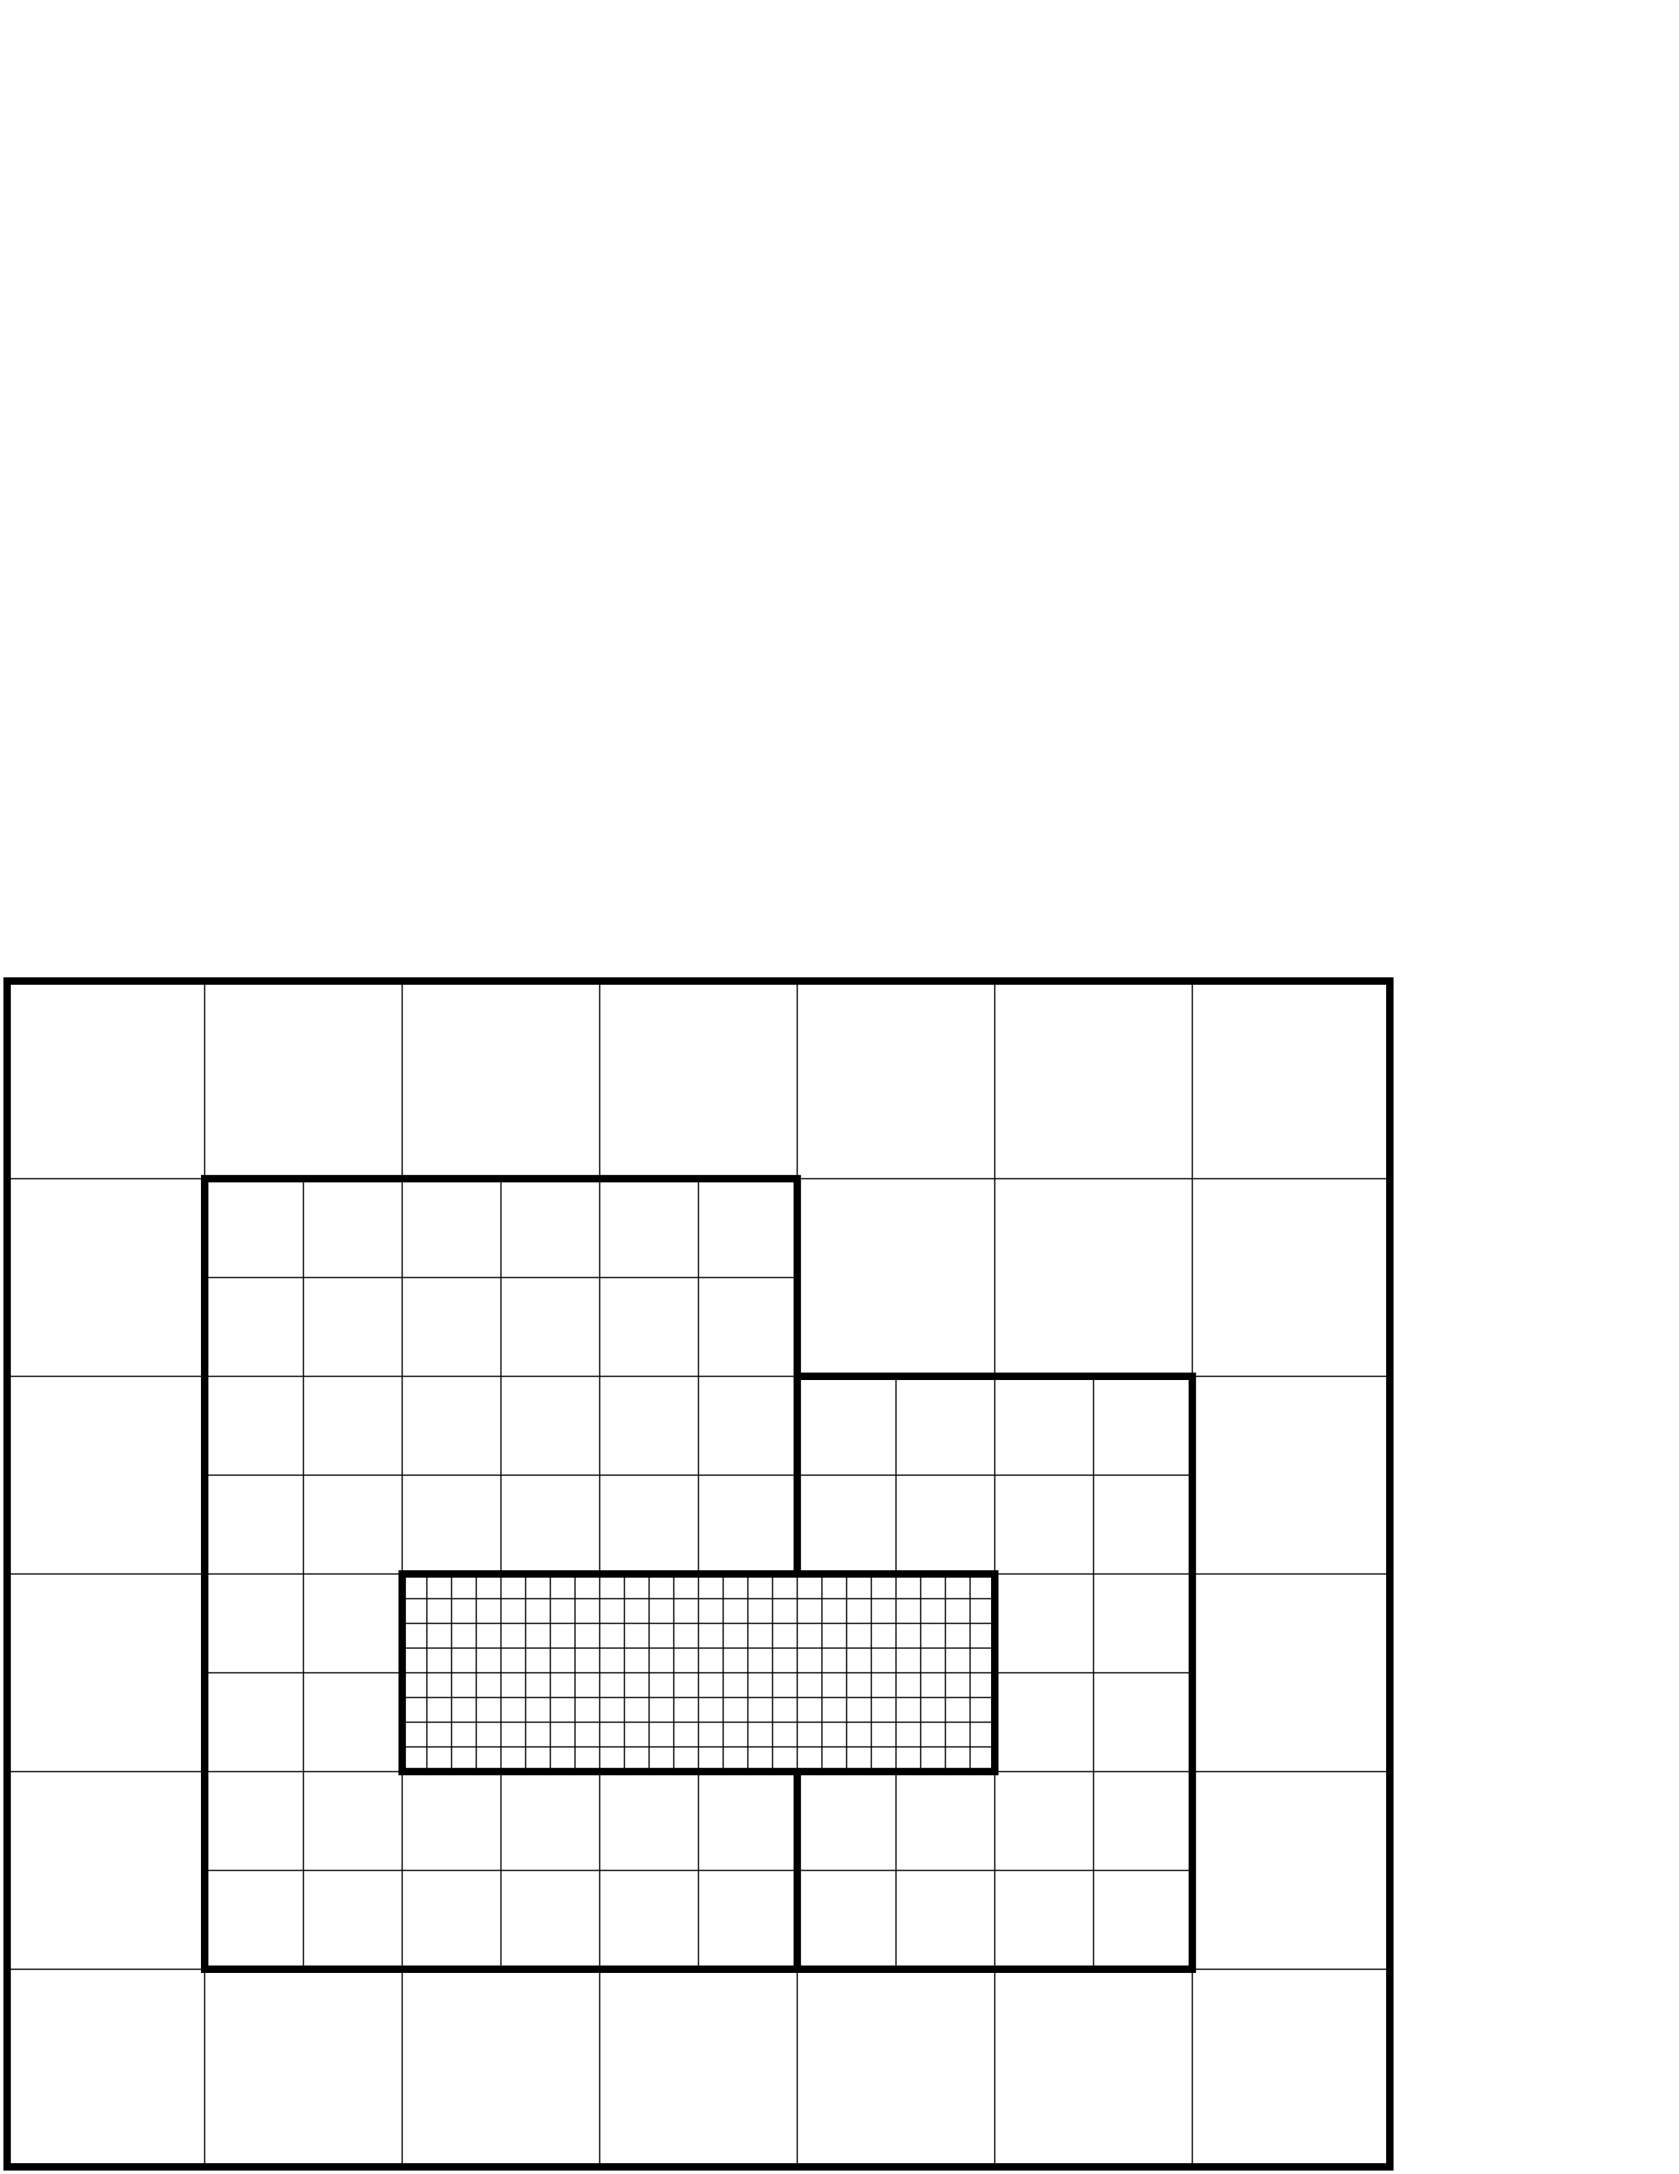
Approach
Locally refine patches where needed to improve the solution.
Each patch is a logically rectangular structured grid.
Better efficiency of data access.
Can amortize overhead of irregular operations over large number of regular operations.
Refined grids are dynamically created and destroyed.

Slide 4
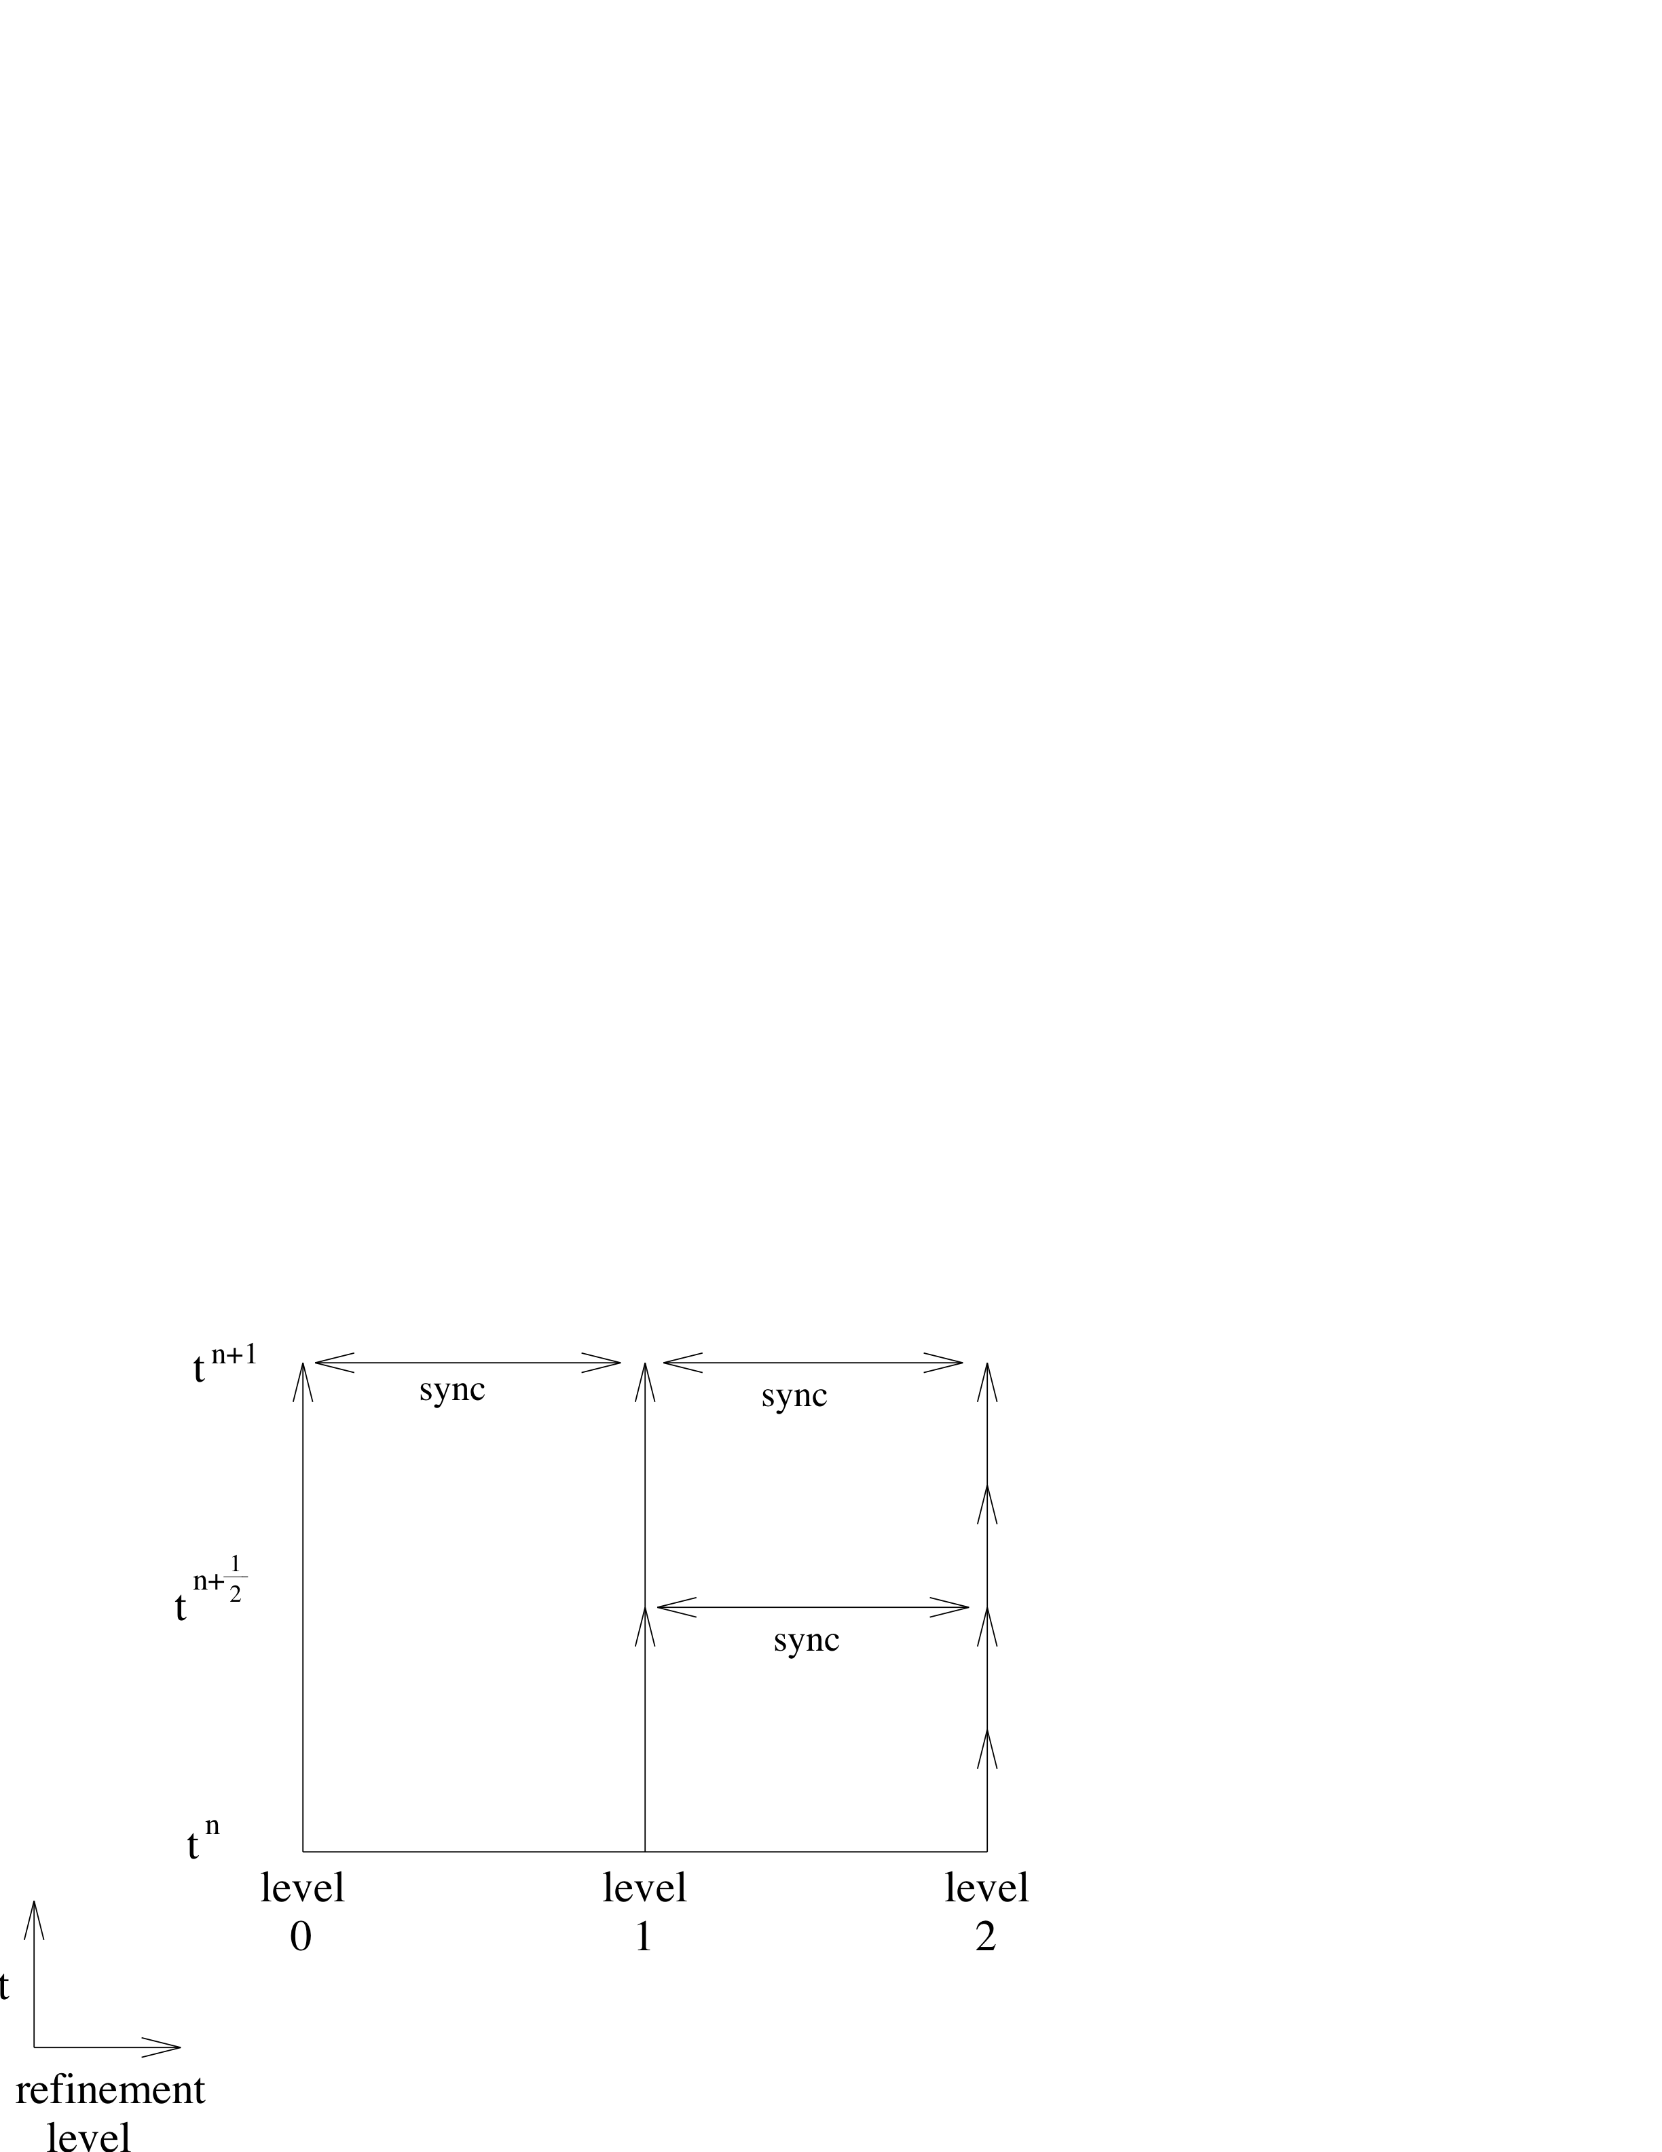
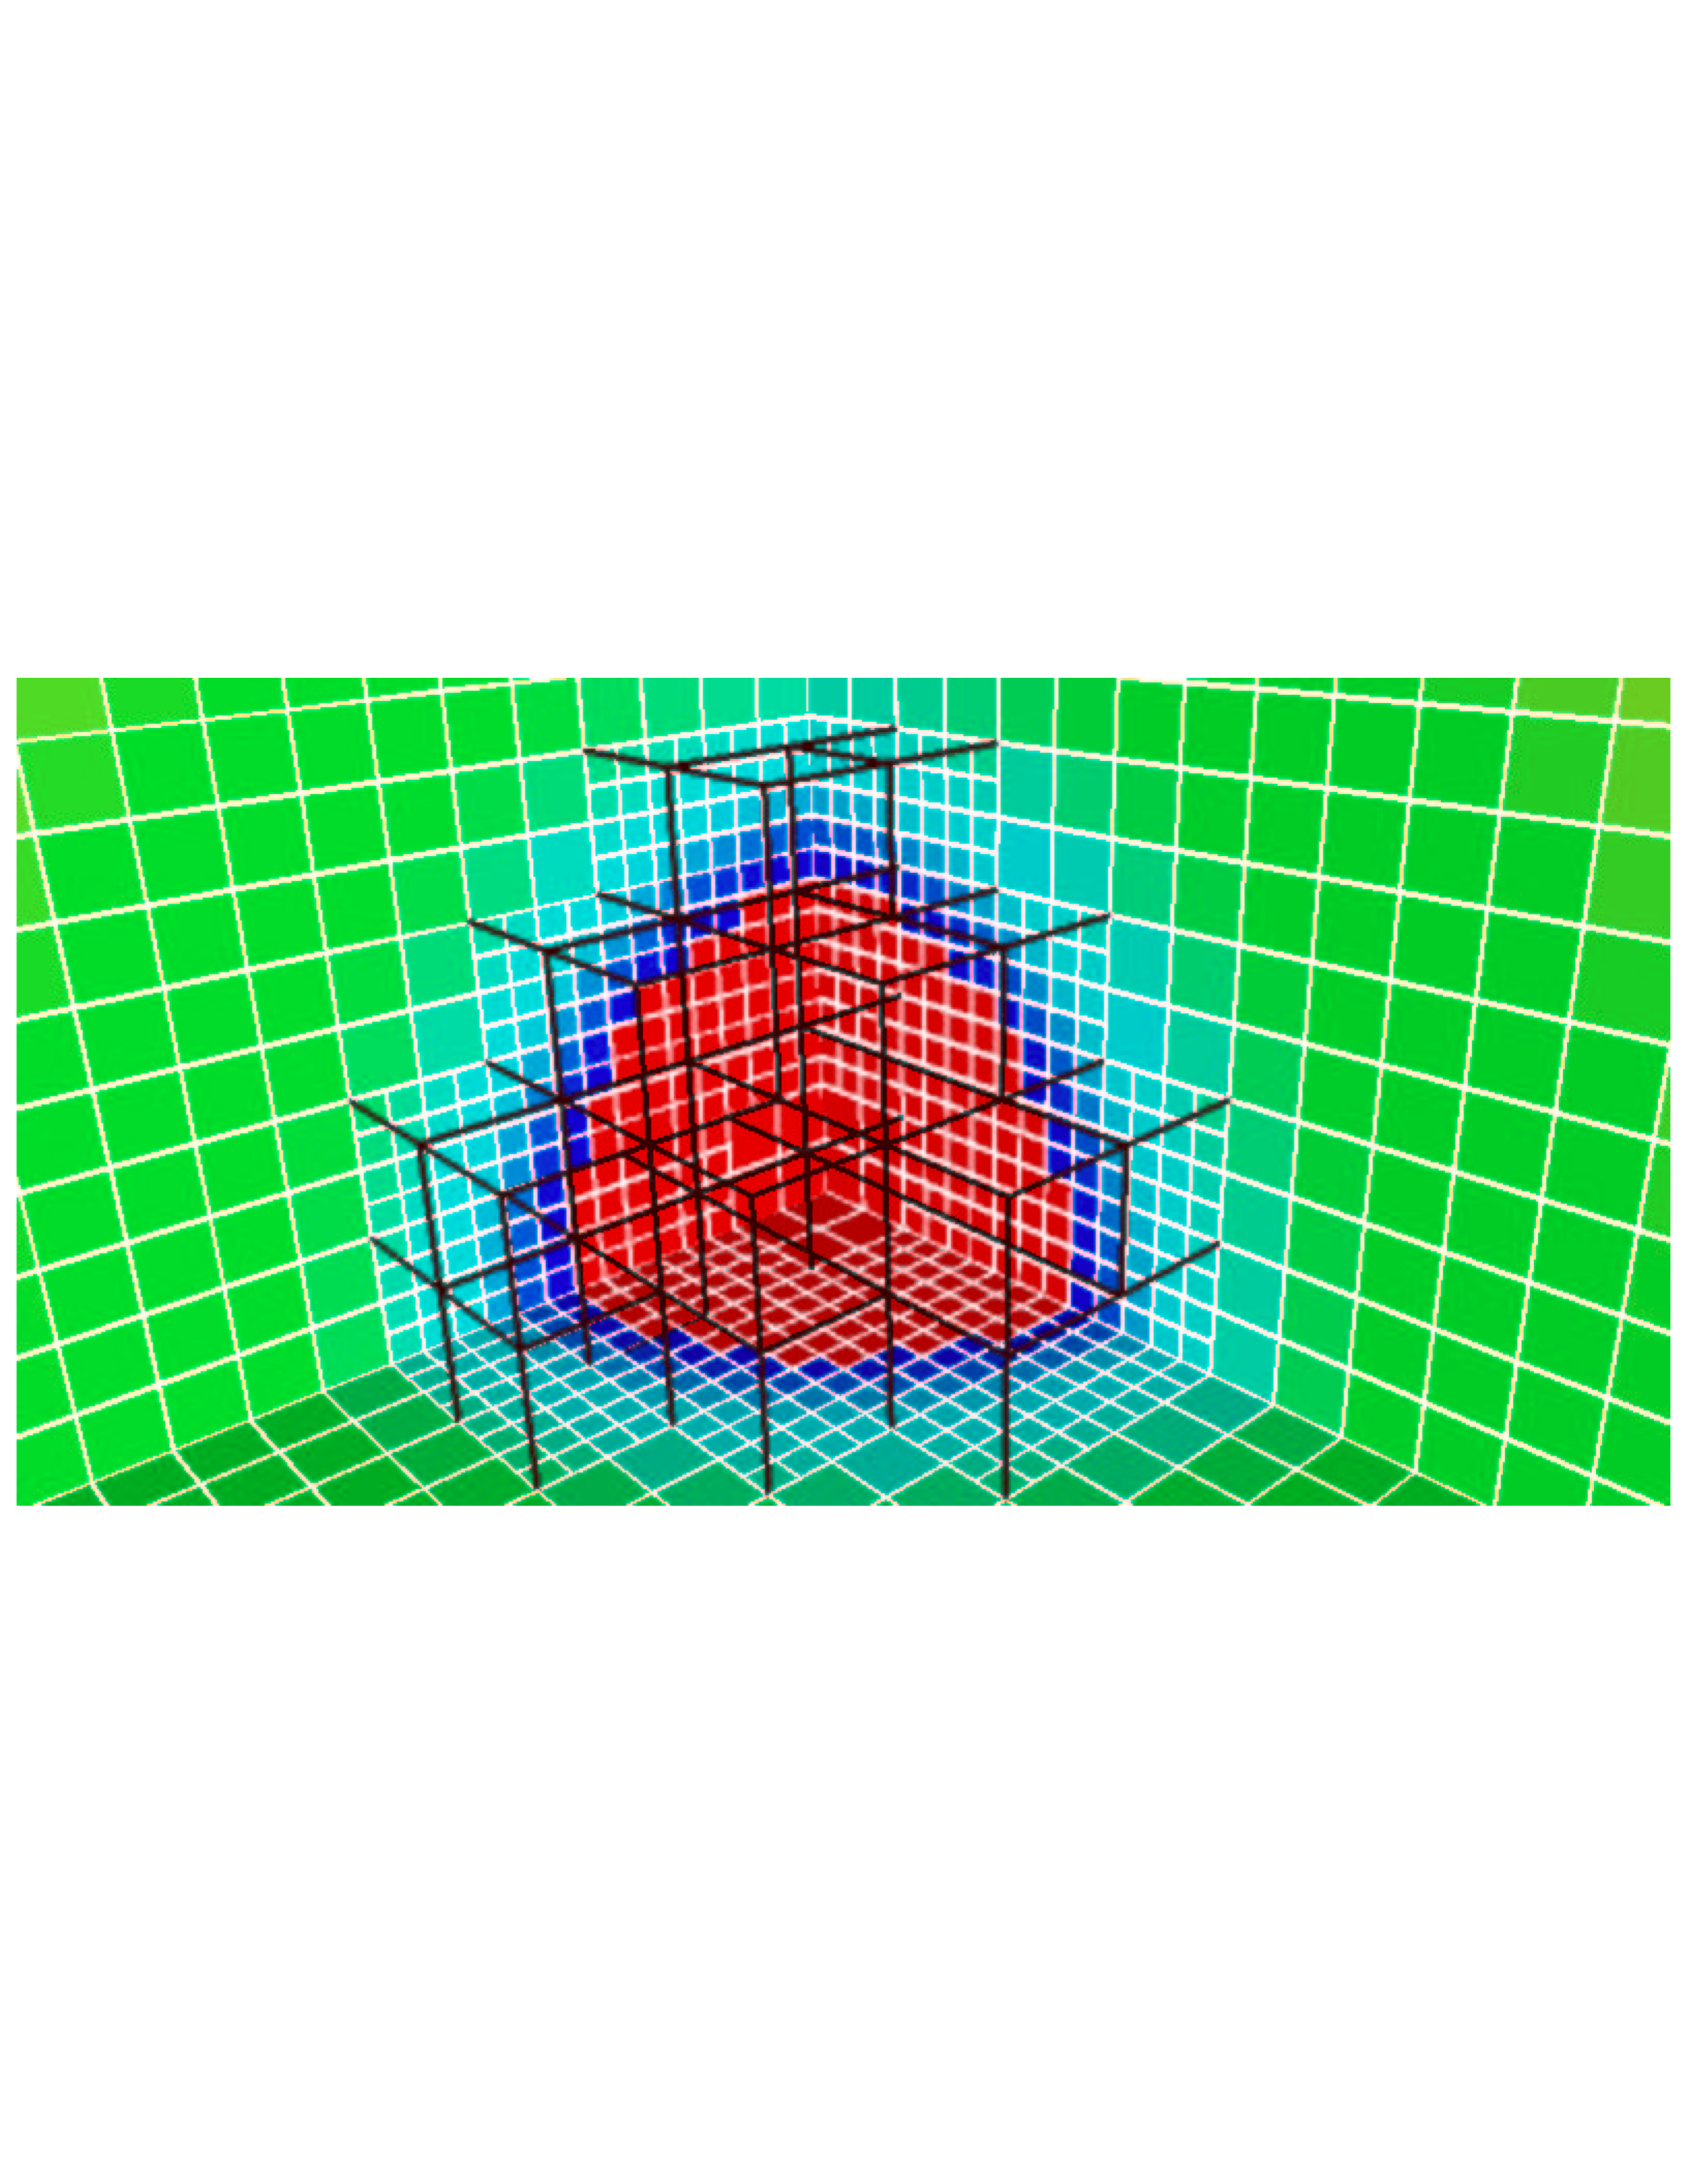
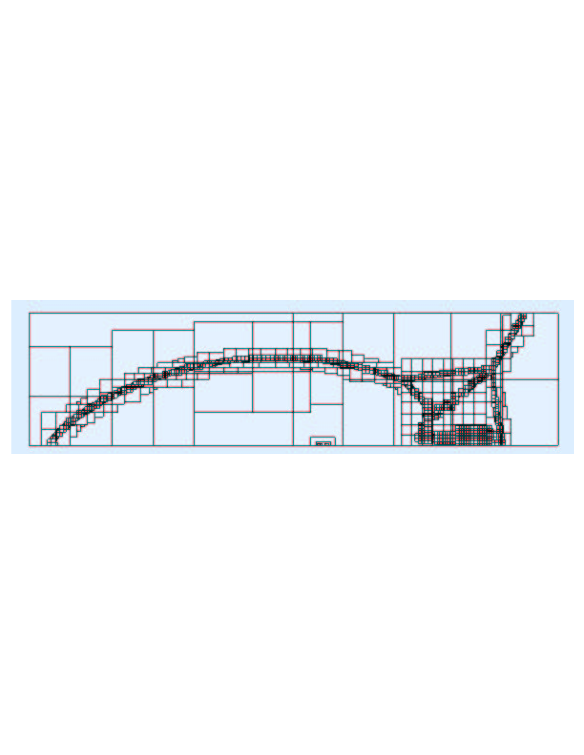
Block-Structured Local Refinement (Berger and Oliger, 1984)
Refined regions are organized into logically-rectangular patches.
Refinement is performed in time as well as in space.

Slide 6
Requirement: to support a wide variety of applications that use block-structured AMR using a common software framework.
Mixed-language model: C++ for higher-level data structures, Fortran for regular single-grid calculations.
Reuseable components. Component design based on mapping of mathematical abstractions to classes.
Build on public-domain standards: MPI, HDF5.
Interoperability with other tools: VisIt, PETSc,hypre.
Previous work: BoxLib (LBNL/CCSE), KeLP (Baden, et. al., UCSD), FIDIL (Hilfinger and Colella).

Slide 7
FAQ
Chombo -- Swahili word meaning ``box''', ``container'', or ``useful thing'’
Freely available, subject to export controls and BSD-like license agreement
Requirements: C++, Fortran compilers, PERL, HDF5 (for I/O), MPI
Supports different precisions (float, double) through use of {\tt Real} data type.
E-mail support: chombo@anag.lbl.gov
Doxygen Reference Manual
http://davis.lbl.gov/Manuals/CHOMBO-SVN/classes.html
Chombo users e-mail group: chombousers@hpcrd.lbl.gov

Slide 8
Layered Design
The empirical nature of multiphysics code development places a premium on the availability of a diverse and agile software toolset that enables experimentation. We accomplish this with a software architecture made up of reusable tested components organized into layers.
Layer 1: Data and operations on unions of rectangles - set calculus, rectangular array library (with interface to Fortran). Data on unions of rectangles, with SPMD parallelism implemented by distributing boxes to processors. Load balancing tools (e.g., SFC).
Layer 2: Tools for managing interactions between different levels of refinement in an AMR calculation - interpolation, averaging operators, coarse-fine boundary conditions.
Layer 3: Solver libraries - multigrid solvers on unions of rectangles, AMR hierarchies; hyperbolic solvers; AMR time stepping.
Layer 4: Complete parallel applications.
Utility Layer: Support, interoperability libraries - API for HDF5 I/O, AMR data alias.

Slide 9
Chombo Directory Structure
Chombo/ (root directory)
lib/
mk/
src/
BaseTools/
BoxTools/
AMRTools/
AMRElliptic/
AMRTimeDependent/
releasedExamples/ (various examples)
AMRPoisson/
exec/
AMRGodunov/
execPolytropic/
execIdealMHD/
execAdvectDiffuse/

Slide 10
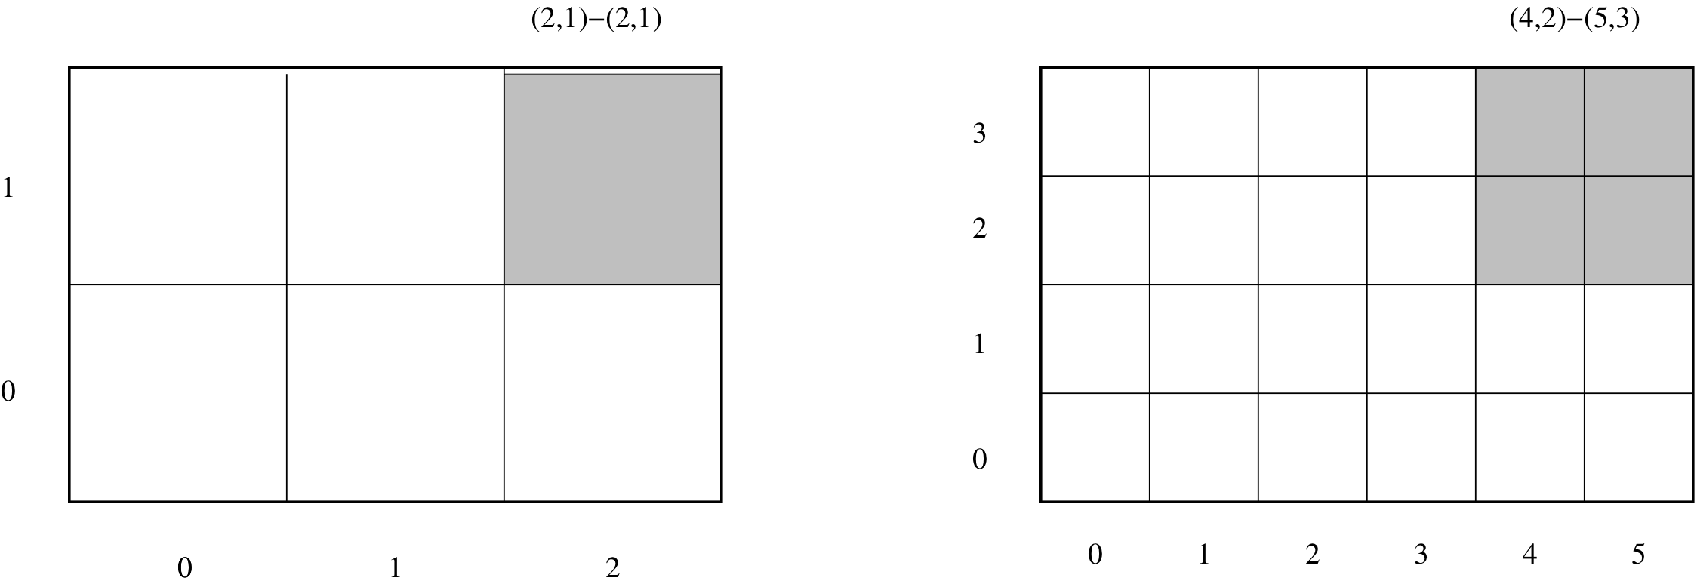
Layer 1 Classes (BoxTools)
Global index spaces:
Each AMR level uses a global index space to locate points in space.
Each level’s index space is related to the others by simple coarsening and refinement operations.
Makes it easy to organize interlevel operations and to perform operations on unions of rectangular grids at a level.

Slide 11
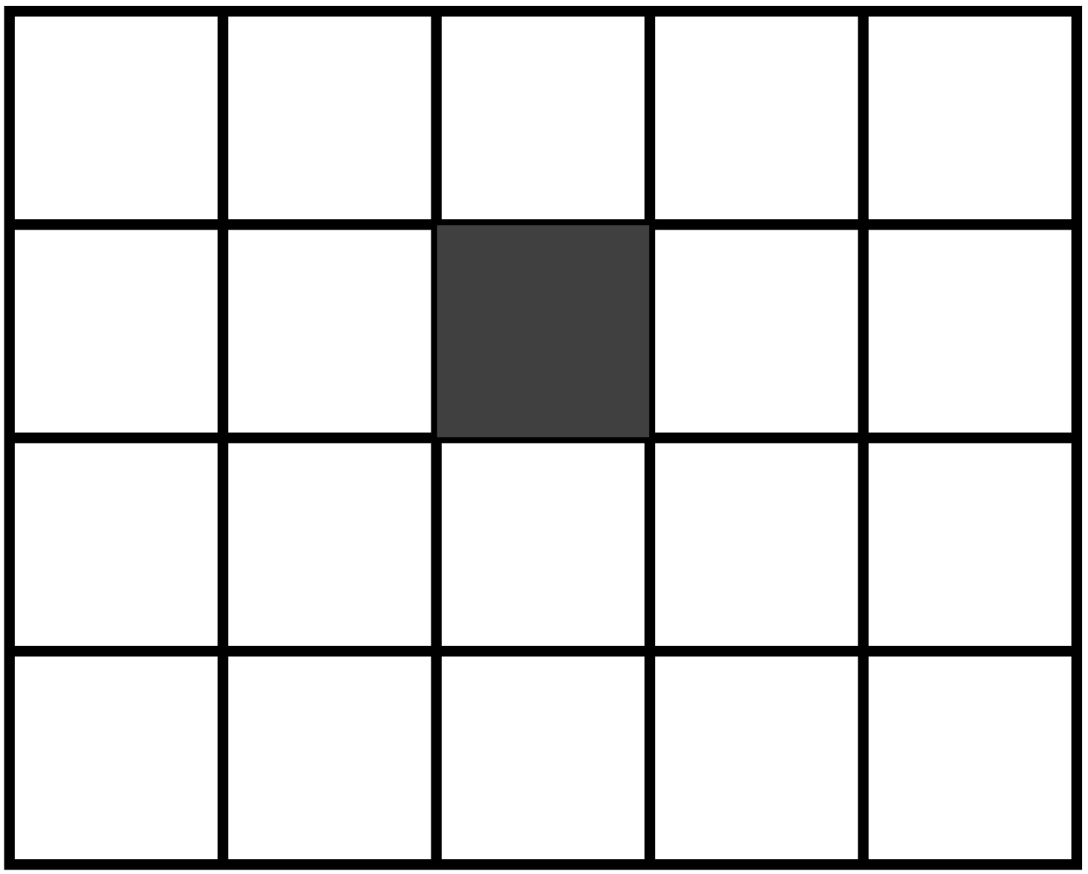
IntVect Class
Location in index space:
Can translate ,coarsen , refine .
2D Example:
IntVect iv(2,3); \\ create IntVect
iv *= 2; \\ multiply by a factor of 2 (now (4,6)
iv.coarsen(2); \\ coarsen by factor of 2 (now 2,3)
IntVect iv2(1,2); \\ second IntVect
iv += iv2; \\ add iv2 to iv -- iv = (3,5)
int i = iv[0]; \\ access 0th component (i = 3)

Slide 12
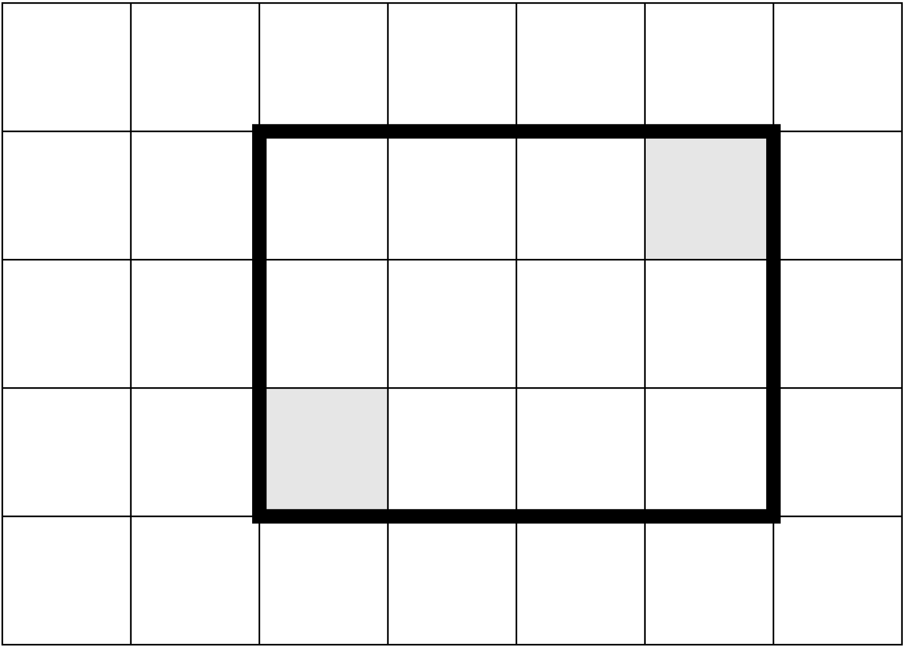
Box Class
is a rectangle in space:
can be translated, coarsened , refined. Supports different centerings (node-centered vs. face-centered) in each coordinate direction.
2D Example:
IntVect lo(1,1), hi(2,3);\\ IntVects to define box extents
Box b(lo,hi); \\ define cell-centered box
b.refine(2); \\ refine by factor of 2: now (2,2)-(5,7)
b.coarsen(2); \\ coarsen: now back to (1,1)-(2,3)
b.surroundingNodes() \\ convert to node-centering -- (1,1)-(3,4)
b.enclosedCells() \\ back to cell-centering -- (1,1)-(2,3)
Box b2(b) \\ copy constructor
b2.shift(IntVect::Unit); \\ shift b2 by (1,1) -- now (2,2)-(3,4)
b &= b2; \\ intersect b with b2 -- b now (2,2)-(2,3)

Slide 13
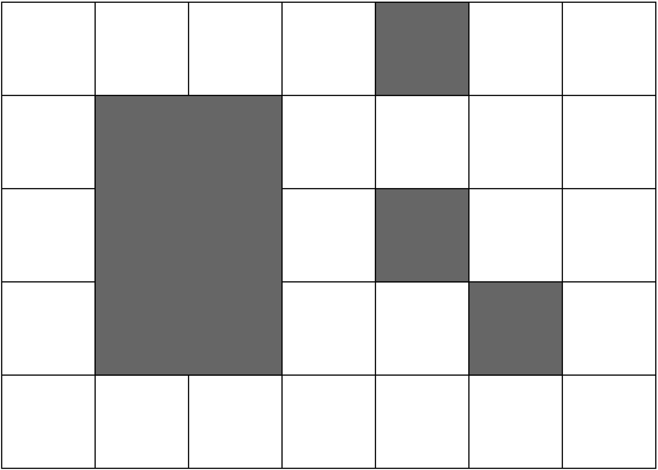
IntVectSet Class
is an arbitrary subset of . Can be shifted, coarsened, refined.
One can take unions and intersections with other IntVectSets and with Boxes, and iterate over an IntVectSet. Useful for representing irregular sets and calculations over such sets.
2D Example:
IntVect iv1, iv2, iv3; \\ various IntVects
Box b; \\ box region
IntVectSet ivSet(b) \\ set of all Index locations in b
ivSet |= iv1; \\ union operator
ivSet.refine(2); \\ refinement of IntVectSet
ivSet.coarsen(2); \\ coarsen back to original
ivSet -= iv2; \\ remove iv2 from intVectSet
ivSet.grow(1); \\ grow intVectSet by a radius of 1

Slide 14
BaseFAB<T> Container Class
Templated muiltidimensional array container class for (int, Real, etc) over region defined by a Box.
2D Example:
Box domain(IntVect::Zero, 3*IntVect::Unit); // box from (0,0)->(3,3)
int nComp = 2; // 2 components
BaseFab<int> intfab(domain, nComp); // define container for int's
intfab.setVal(1); // set values to 1
BoxIterator bit(domain); // iterator over domain
for (bit.begin(); bit.ok(); ++bit)
{
iv = bit();
ival(iv,0) = iv[0]; // set 0th component at
} // iv to index
int* ptr = ifab.dataPtr(); // pointer to the contiguous
// block of data which can
// be passed to Fortran.

Slide 15
FArrayBox Class
Specialized BaseFAB<T> with additional floating-point operations – can add, multiply, divide, compute norms.
Example:
Box domain;
FArrayBox afab(domain, 1); // define single-component FAB's
FArrayBox bfab(domain, 1);
afab.setVal(1.0); // afab = 1 everywhere
bfab.setVal(2.0); // set bfab to be 2
afab.mult(2.0); // multiply all values in afab by 2
afab.plus(bfab); // add bfab to afab (modifying afab)

Slide 16
Example: explicit heat equation solver on a single grid.
// C++ code:
Box domain(IntVect:Zero,(nx-1)*IntVect:Unit);
FArrayBox soln(grow(domain,1), 1);
soln.setVal(1.0);
for (int nstep = 0;nstep < 100; nstep++)
{
heatsub2d_(soln.dataPtr(0),
&(soln.loVect()[0]), &(soln.hiVect()[0]),
&(soln.loVect()[1]), &(soln.hiVect()[1]),
domain.loVect(), domain.hiVect(),
&dt, &dx, &nu)
}

Slide 17
Example: explicit heat equation solver on a single grid.
c Fortran code:
subroutine heatsub2d(phi,nlphi0, nhphi0,nlphi1, nhphi1,
& nlreg, nhreg, dt, dx, nu)
real*8 phi(nlphi0:nhphi0,nlphi1:nhphi1)
real*8 dt,dx,nu
integer nlreg(2),nhreg(2)
c Remaining declarations, setting of boundary conditions goes here.
do j = nlreg(2), nhreg(2)
do i = nlreg(1), nhreg(1)
lapphi = (phi(i+1,j) +phi(i,j+1) +phi(i-1,j) +phi(i,j-1)
& -4.0d0*phi(i,j))/(dx*dx)
phi(i,j) = phi(i,j) + nu*dt*lapphi
enddo
enddo
return
end

Slide 18
ChomboFortran
ChomboFortran is a set of macros used by Chombo for:
Managing the C++ / Fortran Interface.
Writing dimension-independent Fortran code.
Advantages to ChomboFortran:
Enables fast (2D) prototyping, and nearly immediate extension to 3D.
Simplifies code maintenance and duplication by reducing the replication of dimension-specific code.

Slide 19
Previous C++/Fortran Interface
C++ call site:
heatsub2d_(soln.dataPtr(0),
&(soln.loVect()[0]), &(soln.hiVect()[0]),
&(soln.loVect()[1]), &(soln.hiVect()[1]),
domain.loVect(), domain.hiVect(),
&dt, &dx, &nu);
Fortran code:
subroutine heatsub2d(phi,iphilo0, iphihi0,iphilo1, iphihi1,
& domboxlo, domboxhi, dt, dx, nu)
real*8 phi(iphilo0:iphihi0,iphilo1:iphihi1)
real*8 dt,dx,nu
integer domboxlo(2),domboxhi(2)
Managing such an interface is error-prone and dimensionally dependent (since 3D will have more index arguments for array sizing).

Slide 20
C++ / Fortran Interface with ChomboFortran
C++ call site:
FORT_HEATSUB(CHF_FRA(soln),
CHF_BOX(domain),
CHF_REAL(dt), CHF_REAL(dx), CHF_REAL(nu));
Fortran code:
subroutine heatsub(CHF_FRA[phi], CHF_BOX[domain],
& CHF_REAL[dt], CHF_REAL[dx], CHF_REAL[nu])
ChomboFortran expands the argument lists on both sides depending on the dimensionality of the problem. On the Fortran side, it also generates the type declarations for the arguments automatically, along with appropriate header files to be included in the C++ code.

Slide 21
Dimension-independence with ChomboFortran
Looping macros: CHF_MULTIDO
Array indexing: CHF_IX
Replace
do j = nlreg(2), nhreg(2)
do i = nlreg(1), nhreg(1)
phi(i,j) = phi(i,j) + nu*dt*lphi(i,j)
enddo
enddo
with
CHF_MULTIDO[dombox; i;j;k]
phi(CHF_IX[i;j;k]) = phi(CHF_IX[i;j;k])
& + nu*dt*lphi(CHF_IX[i;j;k])
CHF_ENDDO
Prior to compilation, ChomboFortran replaces the indexing and looping macros with code appropriate to the dimensionality of the problem.

Slide 22
Dimension-independence with ChomboFortran
CHF_DDECL and CHF_DTERM macros:
Replace
integer i,j,k
real*8 x,y,z
x = i*dx
y = j*dx
z = k*dx
with
integer CHF_DDECL[i;j;k]
REAL_T CHF_DDECL[x;y;z]
CHF_DTERM[
x = i*dx;
y = j*dx;
z = k*dx]

Slide 23
SPMD Parallelism
SPMD = Single Program, Multiple Data
All processors execute the same code.
Computation can only be done using data that is resident on the processor.
Communication of data between processors is done by separate, explicit calls to communications libraries (MPI).
Chombo hides the low-level details of communication through higher-level libraries, and the use of iterators that restrict computation to data that is resident on the processor.

Slide 24
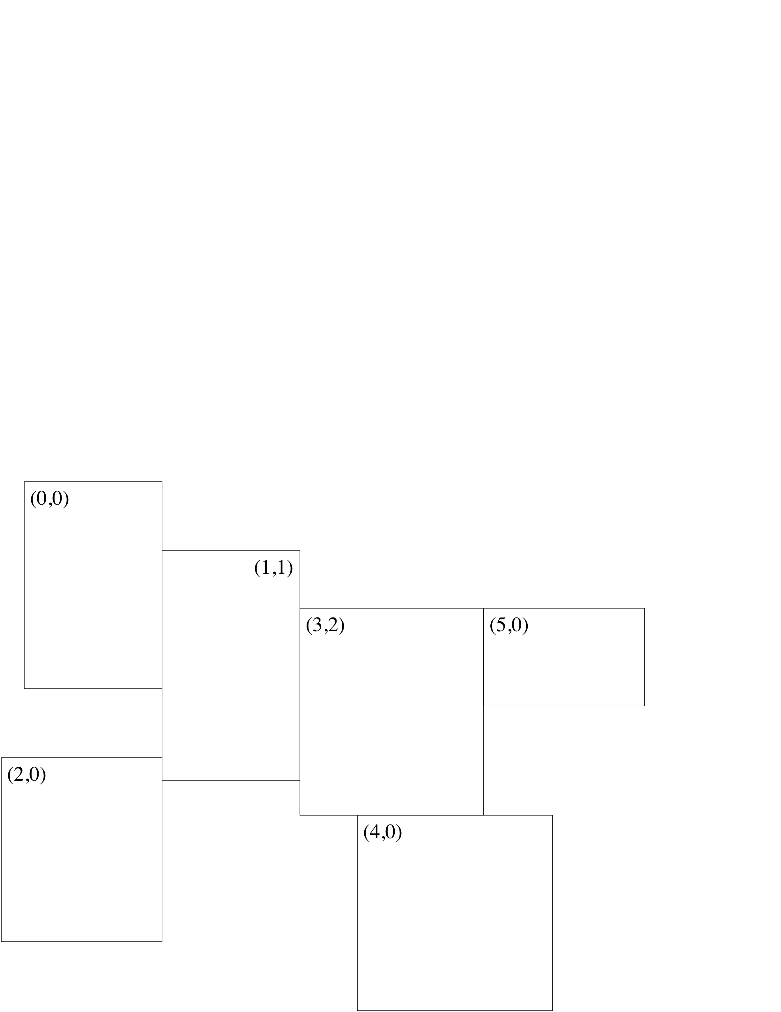
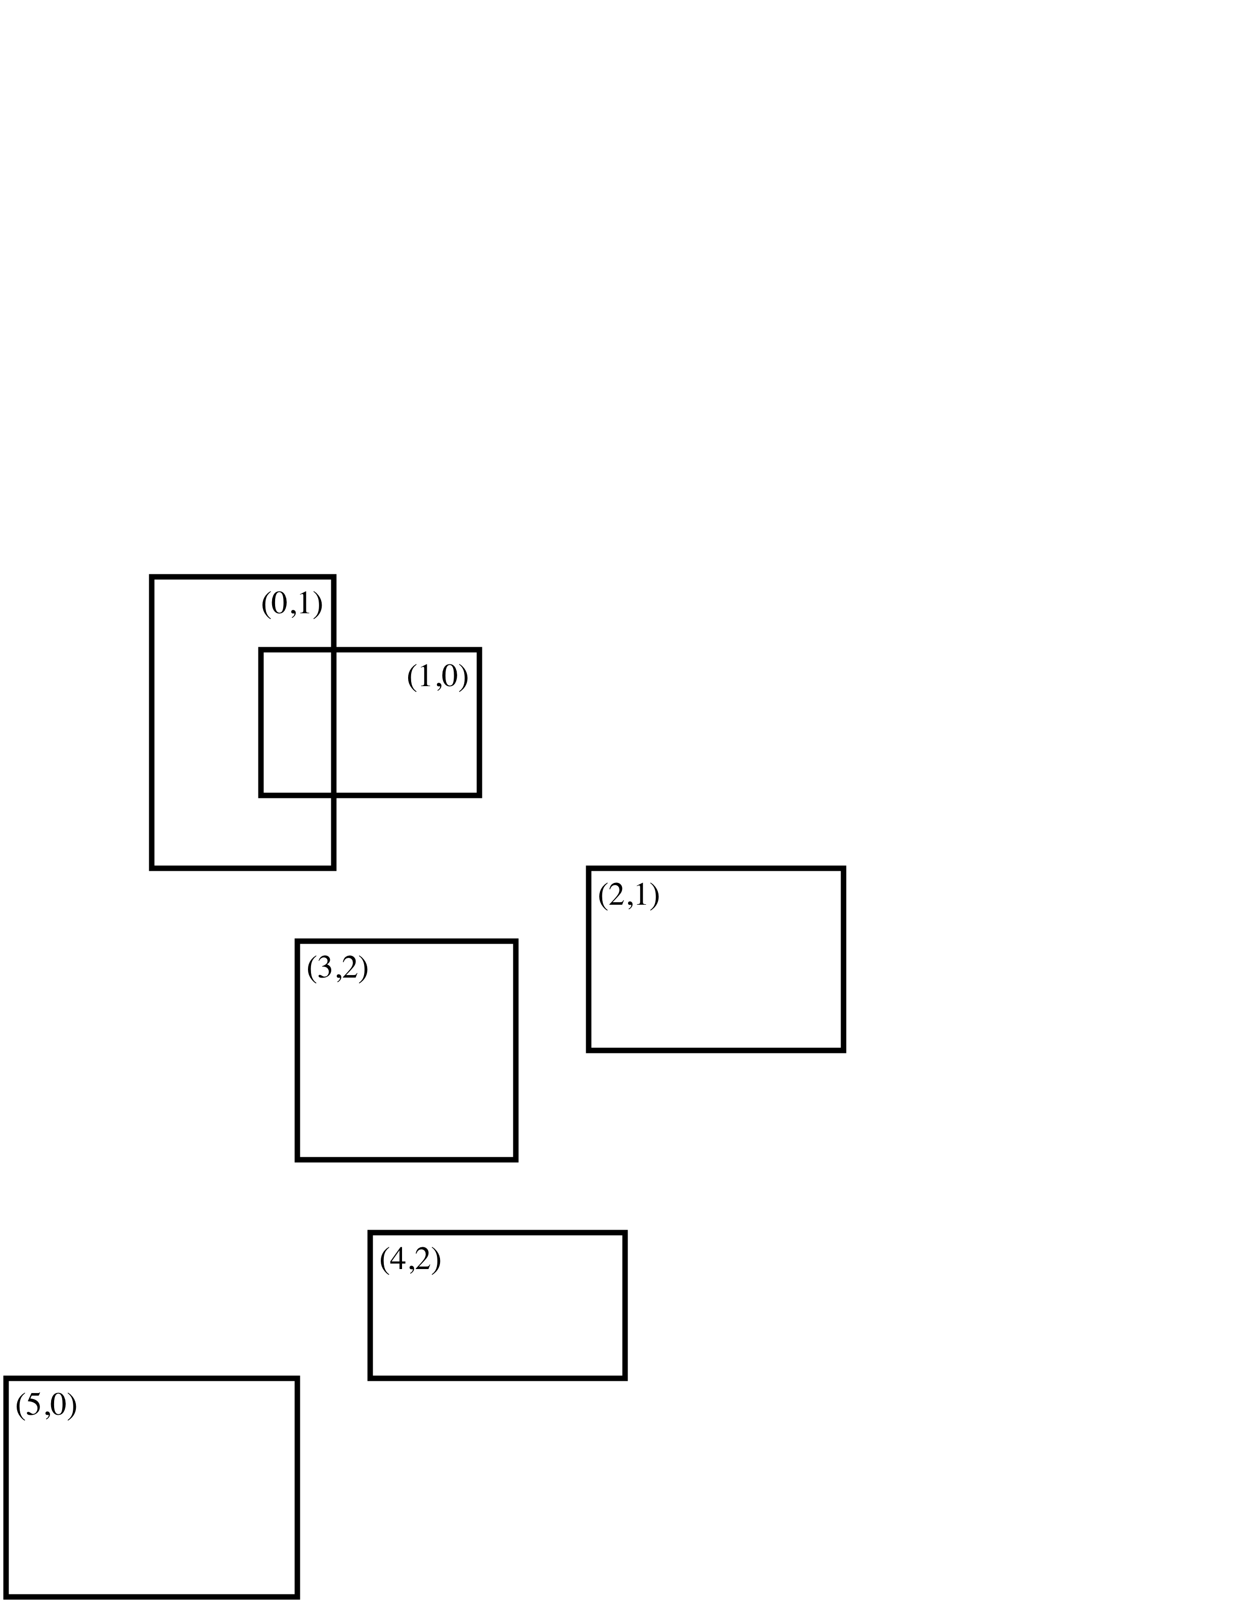
Distributed Data on Unions of Rectangles
Provides a general mechanism for distributing data defined on unions of rectangles onto processors, and expressing communications between processors.
Metadata, of which all processors have a copy. BoxLayout is a collection of Boxes and processor assignments: {B_{k},p_{k}}_{k=1,ngrids} . DisjointBoxLayout:public Boxlayout is a BoxLayout for which the Boxes must be disjoint.

Slide 25
ProblemDomain Class
Class that encapsulates the computational domain.
Basic implementation: essentially a Box with periodicity information.
In most cases, periodicity is hidden from the user and is handled as a wrapping of the index space.

Slide 26
BoxLayout Operations
Set of Boxes which comprise the valid regions on a single level, including processor assignments for each rectangular region.
Two ways to iterate through a BoxLayout
LayoutIterator – iterates through all boxes in the BoxLayout, regardless of which processor they are assigned to.
DataIterator – iterates only through the boxes on this processor.

Slide 27
Example
Vector<Box> boxes; // boxes (from BRMeshRefine or ‘other’)
Vector<int> procAssign; // Which MPI Rank get’s which Box
ProblemDomain domain;
DisjointBoxLayout dbl(boxes, procAssign, domain); // define dbl
// access _all_ boxes
LayoutIterator lit = dbl.layoutIterator();
for (lit.begin(); lit.ok(); ++lit)
{
const Box thisBox = dbl[lit];
unsigned int boxRank = dbl.procID(lit); //not procAssign order
}
// access only local boxes
DataIterator dit = dbl.dataIterator();
for (dit.begin(); dit.ok(); ++dit)
{
const Box& thisLocalBox = dbl[dit];
assert(dbl.procID(dit) == procID());
}

Slide 28
Software Reuse by Templating Dataholders
Classes can be parameterized by types, using the class template language feature in C++.
BaseFAB<T> is a multidimensional array for any type T.
FArrayBox: public BaseFAB<Real>
LevelData<T>, T can be any type that “looks like” a multidimensional array.
Ordinary multidimensional arrays: LevelData<FArrayBox>
Binsorted lists of particles: LevelData<BaseFAB<List<ParticleType>>>
Data structures for embedded boundary methods.

Slide 29
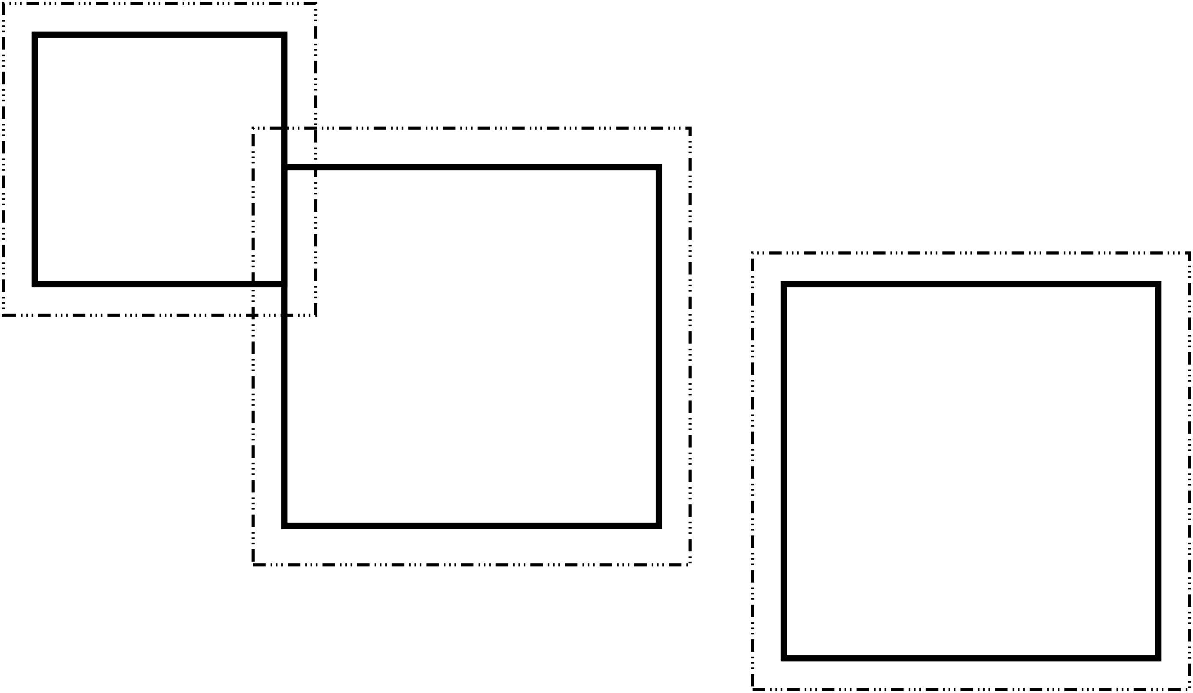
LevelData<T> Class
Distributed data associated with a DisjointBoxLayout. Can have ghost cells around each box to handle intra-level, inter-level, and domain boundary conditions.

Slide 30
Example
DisjointBoxLayout grids;
int nComp = 2; // two data components
IntVect ghostVect(IntVect::Unit) // one layer of ghost cells
LevelData<FArrayBox> ldf(grids, nComp, ghostVect);
// Real distributed data.
LevelData<FArrayBox> ldf2(grids, nComp, ghostVect);
DataIterator dit = grids.dataIterator(); // iterate local data
for (dit.begin(); dit.ok(); ++dit)
{
FArrayBox& thisFAB = ldf[dit];
thisFAB.setVal(procID());
}
// fill ghost cells with "valid" data from neighboring grids
ldf.exchange();
ldf.copyTo(ldf2); \\ copy from ldf->ldf2

Slide 31
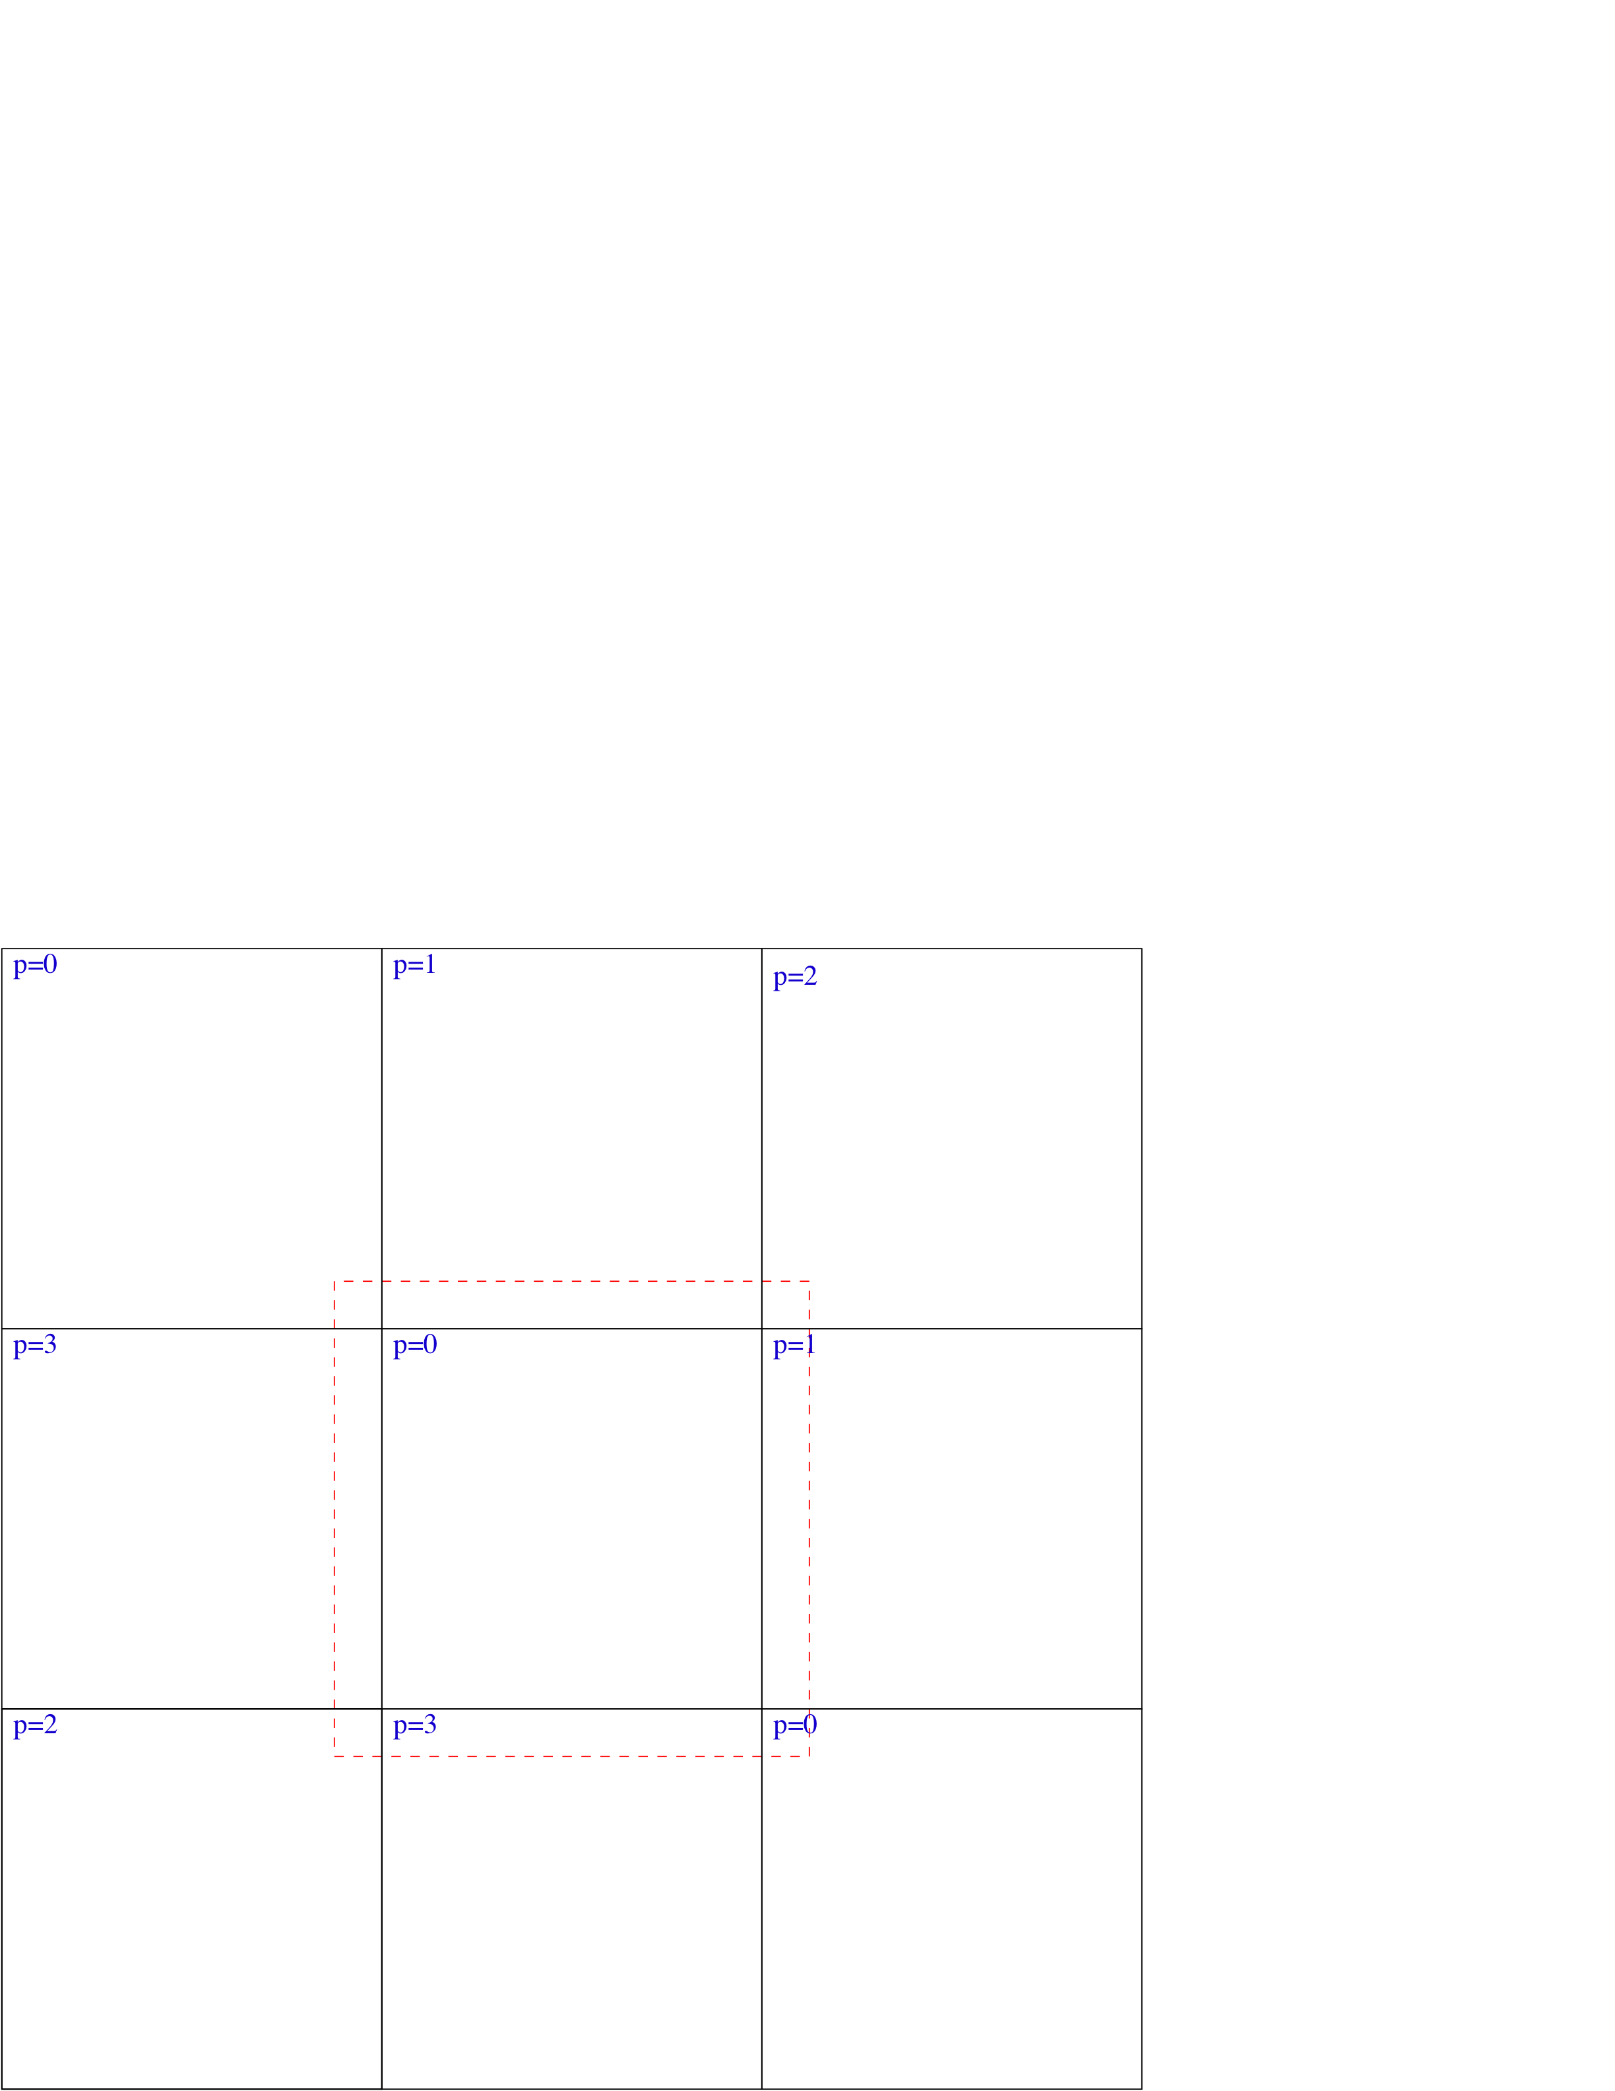
Example Explicit Heat Equation Solver, Parallel Case
Want to apply the same algorithm as before, except that the data for the domain is decomposed into pieces and distributed to processors.

Slide 32
Example Explicit Heat Equation Solver, Parallel Case
// C++ code:
Box domain(IntVect:Zero,(nx-1)*IntVect:Unit);
DisjointBoxLayout dbl;
// Break domain into blocks, and construct the DisjointBoxLayout.
makeGrids(domain,dbl,nx);
LevelData<FArrayBox> phi(dbl, 1, IntVect::TheUnitVector());
for (int nstep = 0;nstep < 100;nstep++)
{
…
// Apply one time step of explicit heat solver: fill ghost cell values,
// and apply the operator to data on each of the Boxes owned by this
// processor.
phi.exchange();

Slide 33
Example Explicit Heat Equation Solver, Parallel Case
DataIterator dit = dbl.dataIterator();
for (dit.reset();dit.ok();++dit)
{
FArrayBox& soln = phi[dit()];
Box& region = dbl[dit()];
FORT_HEATSUB(CHF_FRA(soln),
CHF_BOX(region),
CHF_BOX(domain),
CHF_REAL(dt), CHF_REAL(dx), CHF_REAL(nu));
}
}

Slide 34
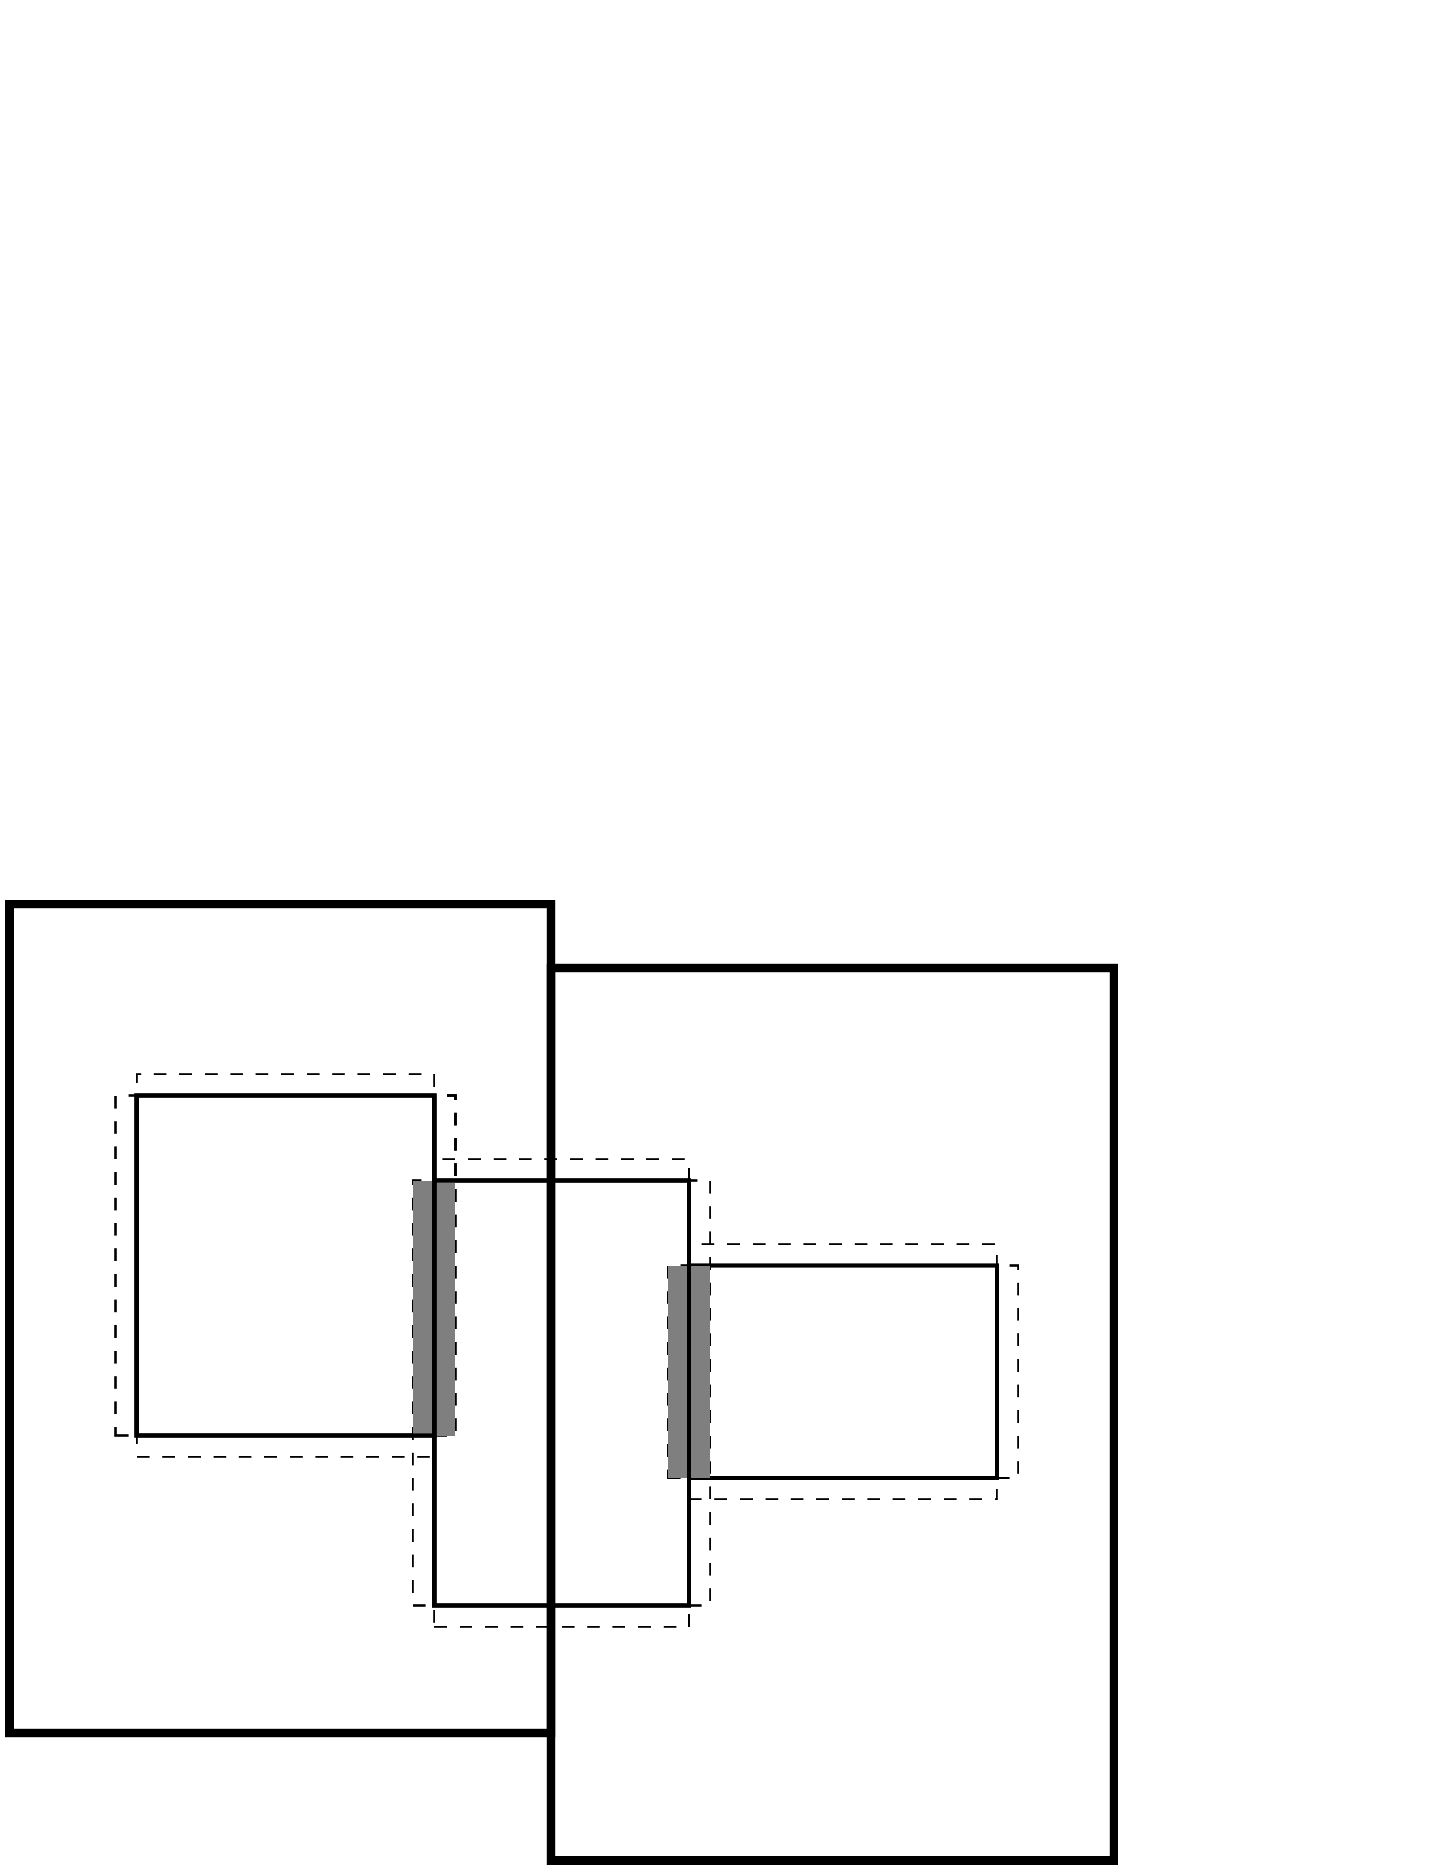
Layer 2 Classes: Coarse-Fine Interactions (AMRTools)
The operations that couple different levels of refinement are among the most difficult to implement, as they typically involve a combination of interprocessor communication and irregular computation.
Interpolation between levels (FineInterp).
Averaging down to coarser grids (CoarseAverage).
Interpolation of boundary conditions (PiecewiseLinearFillpatch, QuadCFInterp, higher-order extensions).
Managing conservation at refinement boundaries (LevelFluxRegister).

Slide 35
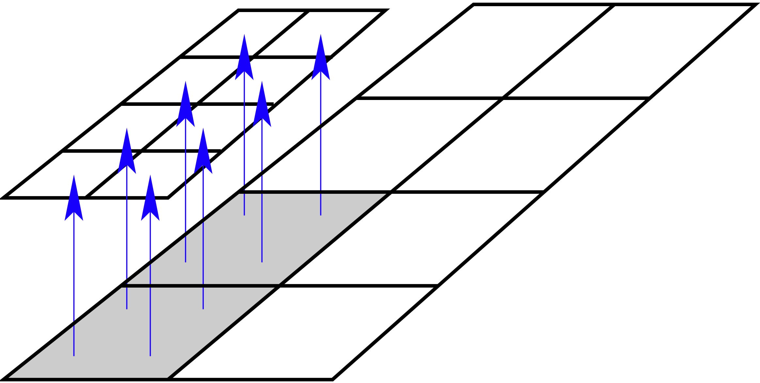
FineInterp Class
Linearly interpolates data from coarse cells to the overlaying fine cells.
Useful when initializing newly-refined regions after regridding.
Example:
ProblemDomain fineDomain;
DisjointBoxLayout coarseGrids, fineGrids;
int refinementRatio, nComp;
LevelData<FArrayBox> coarseData(coarseGrids, nComp);
LevelData<FArrayBox> fineData(fineGrids, nComp);
FineInterp interpolator(fineGrids, nComp, refinementRatio,
fineDomain);
// fineData is filled with linearly interpolated coarseData
interpolator.interpToFine(fineData, coarseData);

Slide 36
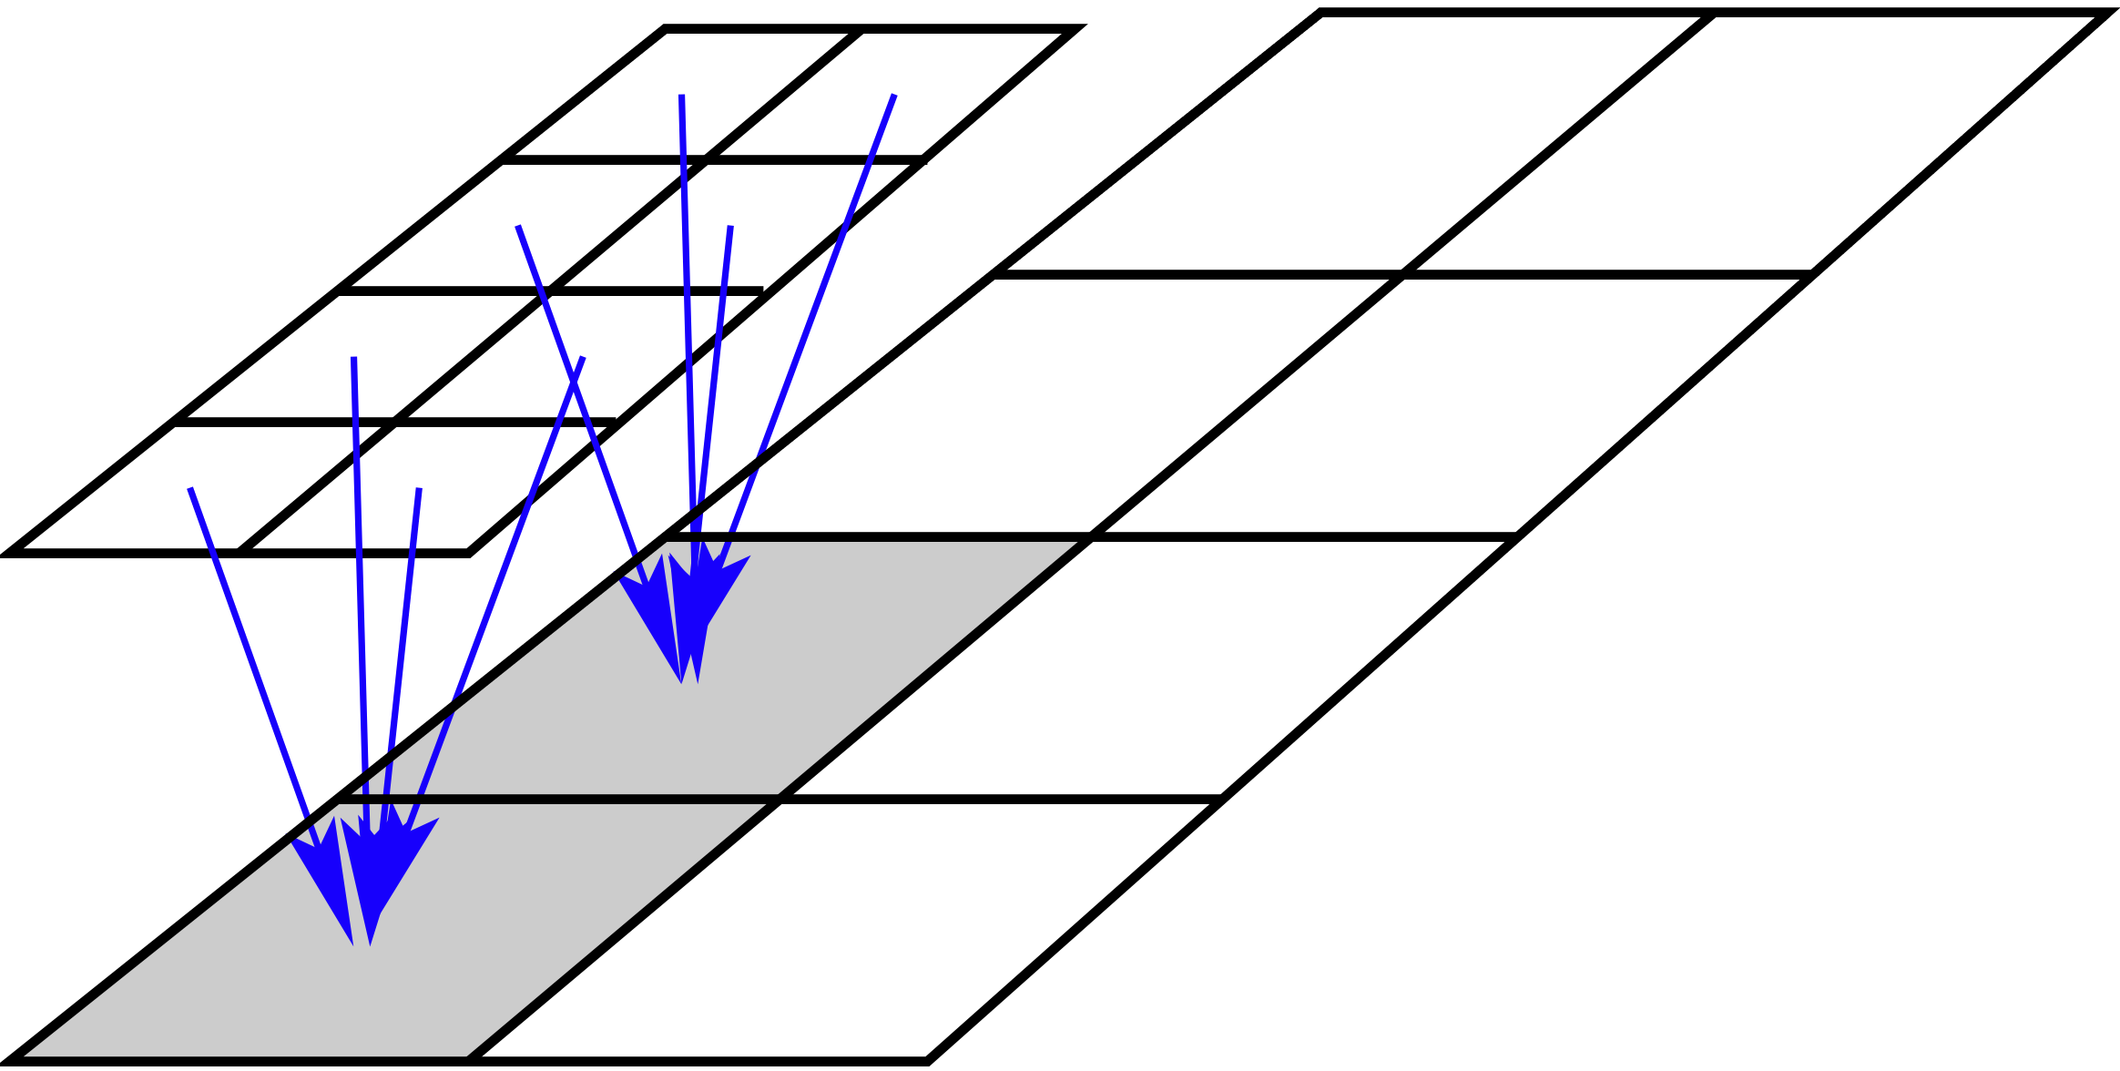
CoarseAverage Class
Averages data from finer levels to covered regions in the next coarser level.
Used for bringing coarse levels into sync with refined grids covering them.
Example:
DisjointBoxLayout fineGrids;
DisjointBoxLayout crseGrids;
int nComp, refRatio;
LevelData<FArrayBox> fineData(fineGrids, nComp);
LevelData<FArrayBox> crseData(crseGrids, nComp);
CoarseAverage averager(fineGrids, crseGrids, nComp, refRatio);
averager.averageToCoarse(crseData, fineData);

Slide 37
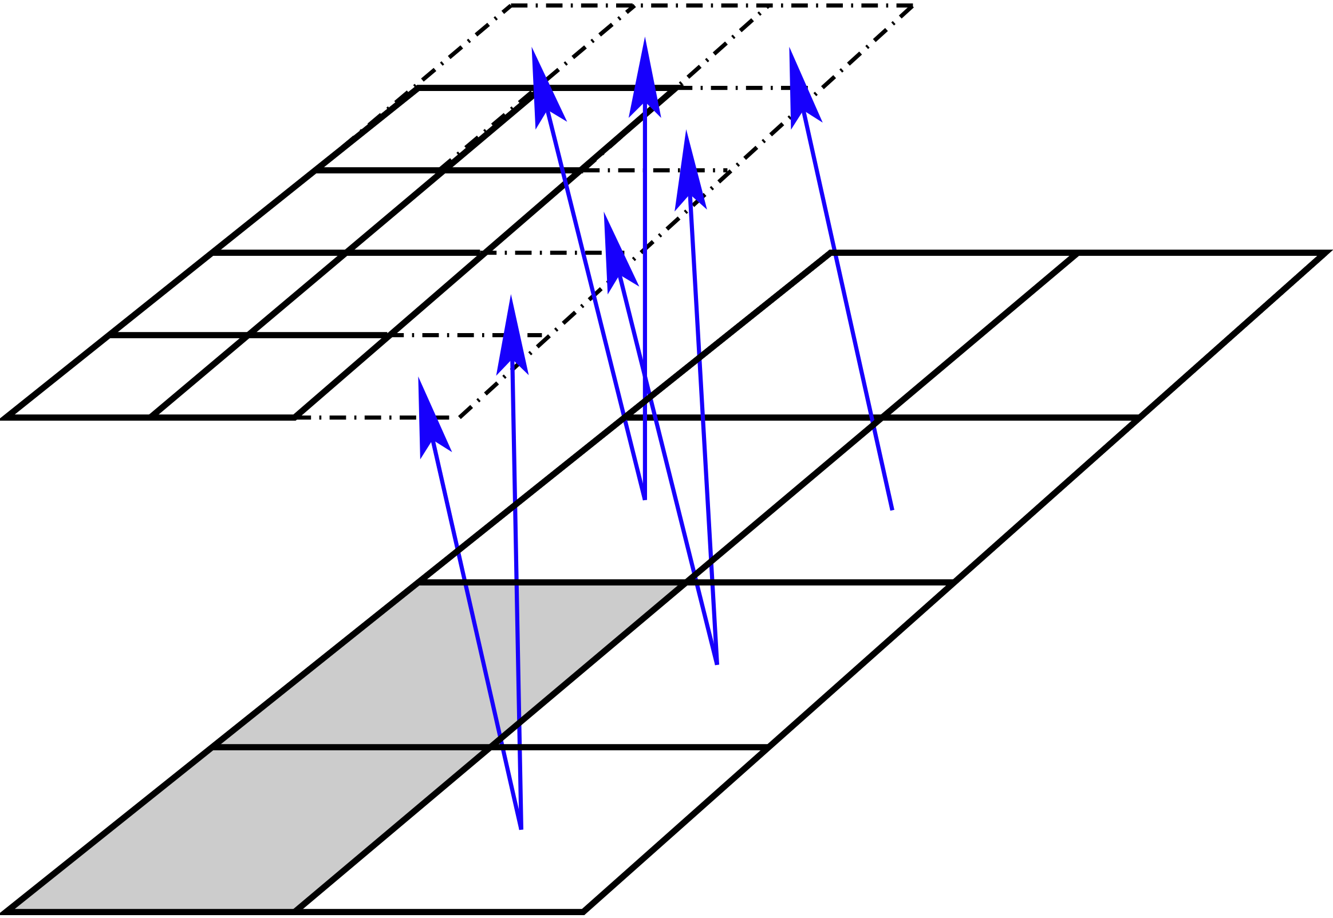
PiecewiseLinearFillPatch Class
Linear interpolation of coarse-level data (in time and space) into fine-level ghost cells.
Example:
ProblemDomain crseDomain;
DisjointBoxLayout crseGrids, fineGrids;
int nComp, refRatio, nGhost;
Real oldCrseTime, newCrseTime, fineTime;
LevelData<FArrayBox> fineData(fineGrids, nComp, nGhost*IntVect::Unit);
LevelData<FArrayBox> oldCrseData(crseGrids, nComp);
LevelData<FArrayBox> newCrseData(crseGrids, nComp);
PiecewiseLinearFillPatch filler(fineGrids, coarseGrids, nComp,
crseDomain, refRatio, nGhost);
Real alpha = (fineTime-oldCrseTime)/(newCrseTime-oldCrseTime);
filler.fillInterp(fineData, oldCrseData, newCrseData, alpha,
0, 0, nComp);

Slide 38
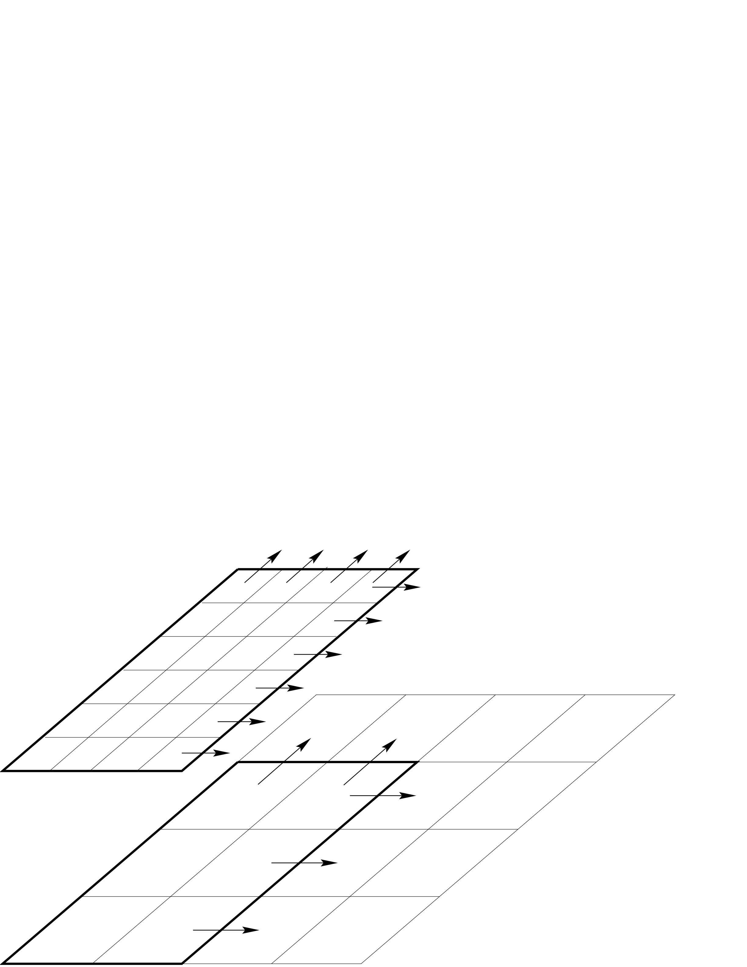
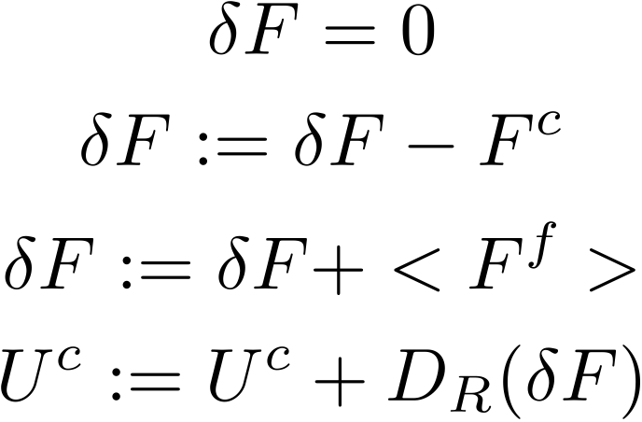
LevelFluxRegister Class
The coarse and fine fluxes are computed at different points in the program, and on different processors. We rewrite the process in the following steps.

Slide 39
LevelFluxRegister Class
A LevelFluxRegister object encapsulates these operations.
LevelFluxRegister::setToZero()
LevelFluxRegister::incrementCoarse: given a flux in a direction for one of the patches at the coarse level, increment the flux register for that direction.
LevelFluxRegister::incrementFine: given a flux in a direction for one of the patches at the fine level, increment the flux register with the average of that flux onto the coarser level for that direction.
LevelFluxRegister::reflux: given the data for the entire coarse level, increment the solution with the flux register data for all of the coordinate directions.

Slide 40
Layer 3 Classes: Reusing control structures via inheritance (AMRTimeDependent, AMRElliptic)
AMR has multilevel control structures that are largely independent of the operations and data.
Berger-Oliger timestepping (refinement in time).
Various linear solver operations, such as multigrid on a single level, multigrid on an AMR hierarchy.
To separate the control structure from the the details of the operation that are being controlled, we use C++ inheritance in the form of interface classes.

Slide 41
Elliptic Solver Example: LinearSolver virtual base class
class LinearSolver<T>
{
// define solver
virtual void define(LinearOp<T>* a_operator, bool a_homogeneous) = 0;
// Solve L(phi) = rhs
virtual void solve(T& a_phi, const T& a_rhs) = 0;
...
}
LinearOp<T> defines what it means to evaluate the operator (for example, a Poisson Operator) and other functions associated with that operator. T can be an FArrayBox (single grid), LevelData<FArrayBox> (single-level), Vector<LevelData<FArrayBox>*> (AMR hierarchy).

Slide 42
Elliptic Solver Example
LinearOp –derived operator classes:
AMRPoissonOp: constant-coefficient Poisson’s equation solver on AMR hierarchy .
VCAMRPoissonOp: variable-coefficient elliptic solver on AMR hierarchy.
LinearSolver –derived control-structure classes:
AMRMultigrid: use multigrid to solve an elliptic equation on a multilevel hierachy of grids, using composite AMR operators. If base level , uses interpolated boundary conditions from coarser level. .
BiCGStabSolver: Use BiConjugate Gradient Stabilized method to solve an elliptic equation (can be single-level, or multilevel). Useful for variable-coefficient problems with strongly-varying coefficients. Also useful as a “bottom solver” for AMRMultiGrid.

Slide 43
Factory Classes
Instead of a single LinearOp, AMRMultigrid needs a set of AMRPoissonOps (one for each level in the AMR hierarchy, along with auxiliary levels required by multigrid.
Solution: Factory classes (AMRPoissonOpFactory). The factory class contains everything required to define the appropriate operator class at any required spatial resolution.
Define function for the AMR hierarchy.
void define(const ProblemDomain& a_coarseDomain,
const Vector<DisjointBoxLayout>& a_grids,
const Vector<int>& a_refRatios,
const Real& a_coarsedx,
BCHolder a_bc,
Real a_alpha = 0.,
Real a_beta = 1.);
AMRPoissonOp* AMRnewOp(const ProblemDomain& a_indexSpace) returns an AMRPoissonOp defined for the given level.

Slide 44
Example: AMR Poisson solve
int numlevels, baselevel;
Vector<DisjointBoxLayout> vectGrids;
Vector<ProblemDomain> vectDomain;
Vector<int> vectRefRatio;
Real dxCrse;
setGrids(vectGrids, vectDomain,dxCrse,
vectRefRatio, numlevels, baselevel);
AMRPoissonOpFactory opFactory;
opFactory.define(vectDomain[0], vectGrids, vectRefRatio,
dxCrse, &bcFunc);
AMRMultiGrid solver;
solver.define(vectDomain[0], opFactory, &bottomSolver, numLevels);
Vector<LevelData<FArrayBox>* > phi(numlevels, NULL);
Vector<LevelData<FArrayBox>* > rhs(numlevels, NULL);
defineStorageAndRHS(phi, rhs, vectGrids);
solver.solveAMR(phi, rhs, numlevels-1, baseLevel);

Slide 45
Example: AMR / AMRLevel Interface for Berger-Oliger Time Stepping
We implement this control structure using a pair of classes:
class AMR: manages the timestepping process.
class AMRLevel : collection of virtual functions called by an AMR object that performs the operations on the data at a level.
virtual void AMRLevel::advance() = 0 advances the data at a level by one time step.
virtual void AMRLevel::postTimeStep() = 0 performs whatever sychronization operations required after all the finer levels have been updated.

Slide 46
AMR / AMRLevel Interface
AMR has as member data a collection of pointers to objects of type AMRLevel, one for each level of refinement.
Vector<AMRLevel*> m_amrlevels;
AMR calls the various member functions of AMRLevel as it advances the solution in time.
m_amrlevels[currentLevel]->advance();
The user implements a class derived from AMRLevel that contains all of the functions in AMRLevel:
class AMRLevelUpwind : public AMRLevel
// Defines functions in the interface, as well as data.
...
virtual void AMRLevelUpwind::advance()
{
// Advances the solution for one time step.
...}
To use the AMR class for a particular applications, m_amrlevel[k] will point to objects in the derived class
AMRLevelUpwind* amrLevelUpwindPtr = new AMRLevelUpwind(...);
m_amrlevel[k] = static_cast <AMRLevel*> (amrLevelUpwindPtr);

Slide 47
Upwind Advection Solver
Simple constant-velocity advection equation:
Discretize on AMR grid using simple 1st-order upwind approach. Piecewise-linear interpolation in space for coarse-fine boundary conditions. .
Refinement in time: linear interpolation in time for coarse-fine boundary conditions. is a conserved quantity, maintain conservation at coarse-fine interface using refluxing.

Slide 48
Upwind Advection Solver
AMRLevelUpwind: public AMRLevel class derived from base AMRLevel class, fills in specific functionality for implementing the upwind advection algorithm.
advance() – advance a single AMR level by one time step using first-order upwind. Initialize / increment flux registers as appropriate.
postTimestep() – synchronization operations: averaging next finer level onto covered region; refluxing.
tagcells(IntVectSet& tags) – specify which cells on a given level will be tagged for refinement.
regrid(const Vector<Box>& newGrids) - given a new grid configuration for this level, re-initialize data.
initialData() - initialize data at the start of the computation.
computeDt() - compute the maximum allowable timestep based on the solution on this level

Slide 49
Upwind Advection Solver
AMRUpwindLevelFactory: public AMRLevelFactory class derived from base AMRLevel class, derived from base AMRLevelFactory class. Used by AMR to define a new AMRLevelUpwind object.
virtual AMRLevel* new_amrlevel – returns a pointer to a new AMRLevelUpwind object.
postTimestep() – Can also be used to pass information through to all AMRLevelUpwind objects in a consistent manner (advection velocity, CFL number,…)

Slide 50
Sample Main Program
// Set up the AMRLevel... factory
AMRLevelUpwindFactory amrLevelFact;
amrLevelFact.CFL(cfl);
amrLevelFact.advectionVel(advection_velocity);
AMR amr;
// Set up the AMR object with AMRLevelUpwindFactory
amr.define(maxLevel,refRatios,probDomain,&amrLevelFact);
// initialize hierarchy of levels from scratch for AMR run
amr.setupForNewAMRRun();
amr.run(stopTime,nstop);
amr.conclude();

Slide 51
AMRLevelUpwind::advance()
Real AMRLevelUpwind::advance()
{
// Copy the new to the old
m_UNew.copyTo(m_UOld);
// fill in ghost cells, if necessary
AMRLevelUpwind* coarserLevelPtr = NULL;
// interpolate from coarser level, if appropriate
if (m_level > 0)
{
coarserLevelPtr = getCoarserLevel();
// get old and new coarse-level data
LevelData<FArrayBox>& crseDataOld = coarserLevelPtr->m_UOld;
LevelData<FArrayBox>& crseDataNew = coarserLevelPtr->m_UNew;
const DisjointBoxLayout& crseGrids = crseDataNew.getBoxes();
Real newCrseTime = coarserLevelPtr->m_time;
Real oldCrseTime = newCrseTime - coarserLevelPtr->m_dt;
Real coeff = (m_time - oldCrseTime)/coarserLevelPtr->m_dt;

Slide 52
AMRLevelUpwind::advance()
const ProblemDomain& crseDomain = coarserLevelPtr->
m_problem_domain;
int nRefCrse = coarserLevelPtr->refRatio();
int nGhost = 1;
PiecewiseLinearFillPatch filpatcher(m_grids, crseGrids,
m_UNew.nComp(), crseDomain,
nRefCrse, nGhost);
filpatcher.fillInterp(m_UOld, crseDataOld, crseDataNew,
coeff, 0, 0, m_UNew.nComp());
}
// exchange copies overlapping ghost cells on this level
m_UOld.exchange();

Slide 53
// now go patch-by-patch, compute upwind flux, and do update
// iterator will only reference patches on this processor
for (dit.begin(); dit.ok(); ++dit)
{
const Box gridBox = m_grids.get(dit());
FArrayBox& thisOldSoln = m_UOld[dit];
FArrayBox& thisNewSoln = m_UNew[dit];
FluxBox fluxes(gridBox, thisOldSoln.nComp());
// loop over directions
for (int dir=0; dir<SpaceDim; dir++)
{
// note that gridbox will be the face-centered one
Box faceBox = fluxes[dir].box();
FORT_UPWIND(CHF_FRA(fluxes[dir]),
CHF_FRA(thisOldSoln),
CHF_REALVECT(m_advectionVel),
CHF_REAL(m_dt),
CHF_REAL(m_dx),
CHF_BOX(faceBox),
CHF_INT(dir));
AMRLevelUpwind::advance()

Slide 54
// increment flux registers with fluxes
Interval UInterval = m_UNew.interval();
if (m_hasFiner)
{
// this level's FR goes between this level and the next finer
m_fluxRegister.incrementCoarse(fluxes[dir], m_dt, dit(),
UInterval, UInterval, dir);
}
if (m_level > 0)
{
LevelFluxRegister& crseFluxReg = coarserLevelPtr->
m_fluxRegister;
crseFluxReg.incrementFine(fluxes[dir], m_dt, dit(), UInterval, UInterval, dir, Side::Lo);
crseFluxReg.incrementFine(fluxes[dir], m_dt, dit(), UInterval, UInterval, dir, Side::Hi);
}
} // end loop over directions
AMRLevelUpwind::advance()

Slide 55
AMRLevelUpwind::advance()
// do flux difference to increment solution
thisNewSoln.copy(thisOldSoln);
for (int dir=0; dir<SpaceDim; dir++)
{
FORT_INCREMENTDIVDIR(CHF_FRA(thisNewSoln),
CHF_FRA(fluxes[dir]),
CHF_BOX(gridBox),
CHF_REAL(m_dx),
CHF_REAL(m_dt),
CHF_INT(dir));
}
} // end loop over grid boxes
// Update the time and store the new timestep
m_time += m_dt;
return m_dt;

Slide 56
AMRLevelUpwind::postTimeStep()
void AMRLevelUpwind::postTimeStep()
{
if (m_hasFiner)
{
// Reflux
Real scale = -1.0/m_dx;
m_fluxRegister.reflux(m_UNew,scale);
// Average from finer level data
AMRLevelUpwind* finerLevelPtr = getFinerLevel();
LevelData<FArrayBox>& fineU = finerLevelPtr->m_UNew;
finerLevelPtr->m_coarseAverage.averageToCoarse(m_UNew,
fineU);
}

